Slide 1
Detection of Malicious URLs Using Machine Learning Techniques
Sneha S(CB.SC.P2AIE23018)
Anusri P(CB.SC.P2AIE23019)

Slide 2
CONTENT
Introduction
Conference Papers
Journal Details
Model Diagram
Noise Removal (SMOTE Algorithm)
One Hot Encoding
Linear regression
Logistic regression
Lasso Regression
Ridge Regression
Comparison of Regression models
K-means with KNN
Fuzzy C-means with K-means
K-means with SVM
Baysian Classifier
Naïve Bayes Classifier
Decision tree
Comparison Table for Classifiers
K-means with CNN
RNN
LSTM
GRU
Comparision Table For Neural Network
Conclution

Slide 3
INTRODUCTION
The Malicious URL Detection project is a vital initiative in cybersecurity, dedicated to identifying and categorizing potentially harmful URLs using sophisticated machine learning techniques. In response to the escalating threat of cyber attacks, this project employs advanced models like the Random Forest Classifier to bolster URL security. By addressing the pressing need for effective defenses against malicious online activities, the project seeks to enhance digital safety and resilience. This introduction sets the stage for a detailed exploration of the project's methodology, findings, and implications in fortifying online environments against evolving cyber threats.

Slide 4
Conference Paper
S.No | Paper Name | Conference Name | Citation
1 | Detecting Malicious URL | 2020 International Conference on Computing and Information Technology (ICCIT-1441) | FatimahAlkhudair, Mada Alassaf, Rehan UllahKhan, Shouq Alfarraj
2 | Malicious URL: Analysis and Detection using Machine Learning | 2023 10th International Conference on Computing for Sustainable Global Development (INDIACom) | Mansi Mehndiratta, NamanJain, Ankit Malhotra, Ishika Gupta, Rachna Narula
3 | Malicious URL Detection Using Supervised Machine Learning Techniques | 13th International Conference on Security of Information and Networks | Vara Vundavalli, Farhat Lamia Barsha,Mohammad Masum,Hossain Shahriar,Hisham M
4 | Empirical Study on Malicious URL Detection Using Machine Learning | 15th International Conference, ICDCIT 2019, | Ripon Patgiri,Hemanth Katari,Dheeraj Sharma,Ronit Kumar
5 | Malicious URL Detection System Based on LSTM and Attention Mechanism | International Conference on Applied Innovations in IT 2021 | Bocheng Liu, Xianang Zeng and Pengxiang Dong
6 | Incremental Update based Closed-Loop Malicious URL Detection System | 2022 IEEE 8th International Conference on Computer and Communications (ICCC) | Ziyao Xu Hefei ,Dong Jin,Siyu Cheng, Peng Yu,Shuangwu Chen,Quan Zheng

Slide 5
7 | Malicious URL Detection using Machine Learning Algorithms | Proceedings of the Digital Privacy and Security Conference 2019 | Marcelo Ferreira Lusofona University of Porto, Portugal ferreira_marcelo@outlook.pt
8 | Malicious URL Classification Using Extracted Features, Feature Selection Algorithm, and Machine Learning Techniques | Proceedings of the International Conference on Industrial Engineering and Operations Management Rome, Italy, August 2-5, 2021 | Jo Simon Ambata, Jose Gaurana, Dan Jacinto, and Joel De Goma
9 | A Fast Filter for the Large-Scale Detection of Malicious Web Pages. | 20th International Conference on World Wide Web | Canali .D,Cova.M,Vigna.G, Kruegel, C. Prophiler
10 | Phishing URL Detection: A Network-based Approach Robust to Evasion | Proceedings of the 2022 ACM SIGSAC Conference on Computer and Communications Security | Taeri Kim,Noseong Park,Jiwon Hong,Sang-Wook Kim.

Slide 6
Journal Details
S.No. | Paper Name | Journal Name | Citation
1 | Detection of malicious websites using machine learning Techniques | IEEE Journal | Chukwemeka Okobi,Courage O Ekoh,Kagame Richard, Adebayo Oshingbesan, Aime Munezero.
2 | Malicious URL Detection Using Machine Learning and Deep Learning | International Research Journal of Modernization in Engineering Technology and Science | Amogh J, Rajendra KN, Deekshith NG, S Parikshith, Asst. Prof. Suma L
3 | Malicious URL Detection Using Machine Learning | IJFANS International Journal Of Food And Nutritional Sciences | Koteswara Rao Velpula,Kataru Gayathri Priya, Kushwanth Kumar Jammula,
4 | Malicious Website Detection using Machine Learning | International Journal of Engineering Research & Technology (IJERT) | Liudmila Swati Xess,Tanishka Prasad,Mahek Khera, Ms. Manpreet Kaur Aiden,Rupender Singh
5 | Malicious URL Detection based on Machine Learning | International Journal of Advanced Computer Science and Applications | Cho Do Xuan,H. Nguyen,Tisenko Victor Nikolaevich

Slide 7
6 | Detecting Malicious URLs Using Machine Learning Techniques: Review and Research Directions | IEEE journal | Malak Aljabri,Hanan S. Altamimi,Shahd A. Albelali,Maimunah Al-Harbi,Haya T. Alhuraib
7 | Malicious Url Detection System Using Combined SVM And Logistic Regression Model | International Journal of Advanced Research in Engineering and Technology (IJARET) 45650, Pakistan | R. Naresh ,Ayon Gupta, Sanghamitra Giri
8 | Machine Learning System for Malicious Website Detection using Concept Drift Detection | IJRASET Journal For Research in Applied Science and Engineering Technology | Chaitanya R. Vyawhare, Reshma Y. Totare, Prashant S. Sonawane, Purva B. Deshmukh
9 | Machine Learning Based Malicious Website Detection. | International Journal of Scientific & Engineering Research Volume 11, Issue 7, July-2020 | Jino S Ganesh, Niranjan Swarup.V, Madhan Kumar.R, Harinisree.A, P.G Scholars, Guided by, Dr. Giri Raj.M
10 | An Assessment of Lexical, Network, and Content-Based Features for Detecting Malicious URLs Using Machine Learning and Deep Learning Models | Comput Intell Neurosci. 2022; 2022: 3241216. | Malak Aljabri,Fahd Alhaidari,Rami Mustafa A. Mohammad, Samiha Mirza, Dina H. Alhamed, Hanan S. Altamimi, and Sara Mhd. Bachar Chrouf

Slide 8
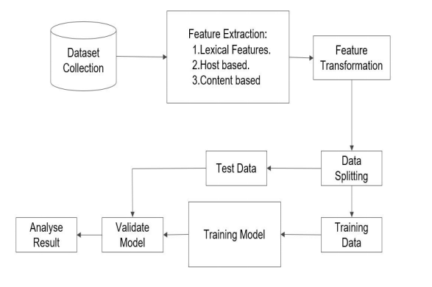
Modal Diagram

Slide 9
Modal Diagram
Data collection: The first step is to collect a dataset of URLs, both malicious and benign. This dataset can be collected from a variety of sources, such as web scraping, honeypots, and public databases.
Feature extraction: Once the dataset is collected, the next step is to extract features from the URLs. Features can be extracted from a variety of sources, such as the URL itself, the domain name, the IP address, and the website content. Some common features include:
Lexical features: These features are extracted from the text of the URL, such as the presence of certain keywords or phrases.
Host-based features: These features are extracted from the domain name and IP address, such as the age of the domain, the country code, and the reputation of the IP address.
Content-based features: These features are extracted from the website content, such as presence of certain words or phrases, the HTML structure of the website, and the presence of malicious code.
Feature selection: Once the features have been extracted, the next step is to select the most informative features. This is important because using too many features can lead to overfitting, which is when the model learns the training data too well and is unable to generalize to new data. There are a variety of feature selection techniques that can be used, such as information gain, chi-squared test, and recursive feature elimination.
Once the features have been selected, they can be used to train a machine learning model to detect malicious URLs. The model can then be used to predict whether a new URL is malicious or benign.

Slide 10
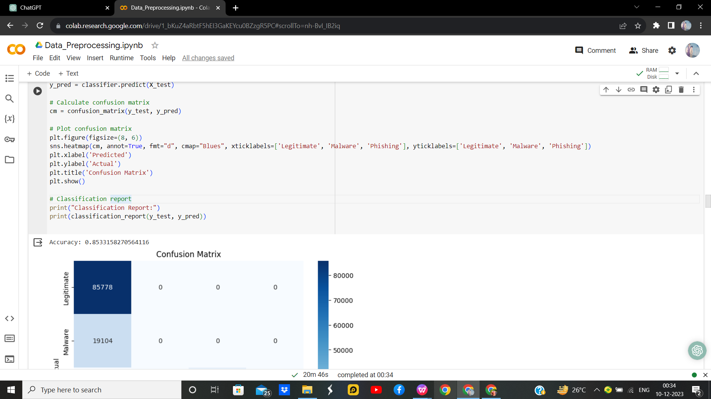
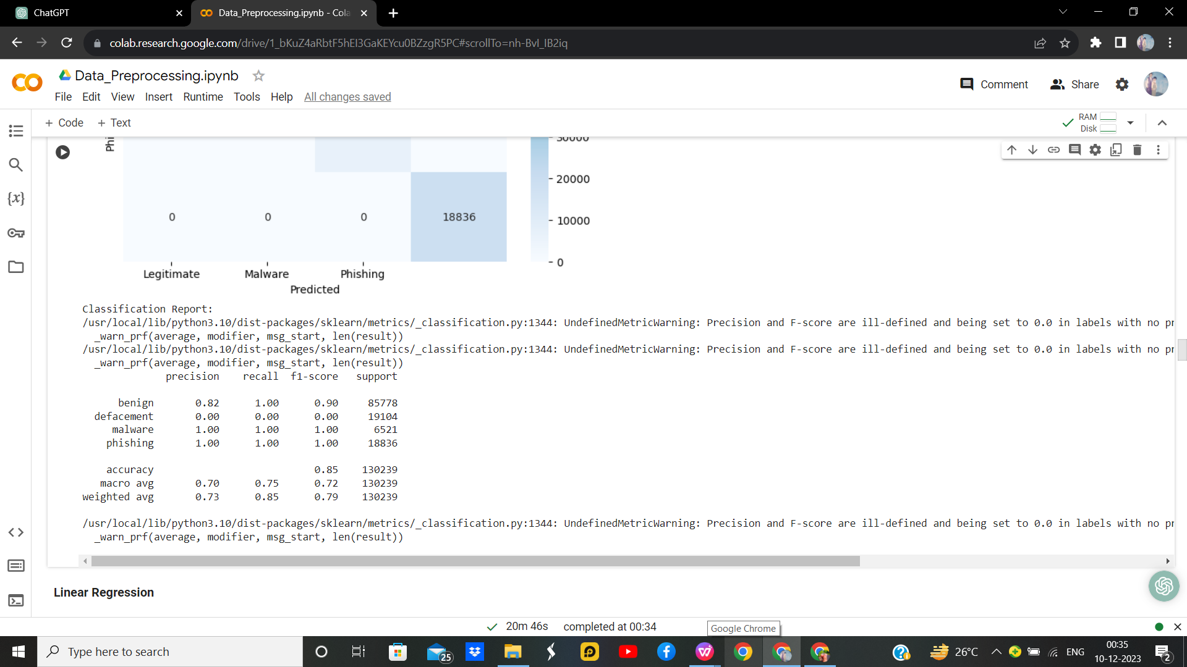
Noise Removal (SMOTE Algorithm)
Synthetic Minority Oversampling Technique - SMOTE is an oversampling technique where the synthetic samples are generated for the minority class. This algorithm helps to overcome the overfitting problem posed by random oversampling. It focuses on the feature space to generate new instances with the help of interpolation between the positive instances that lie together.

Slide 11
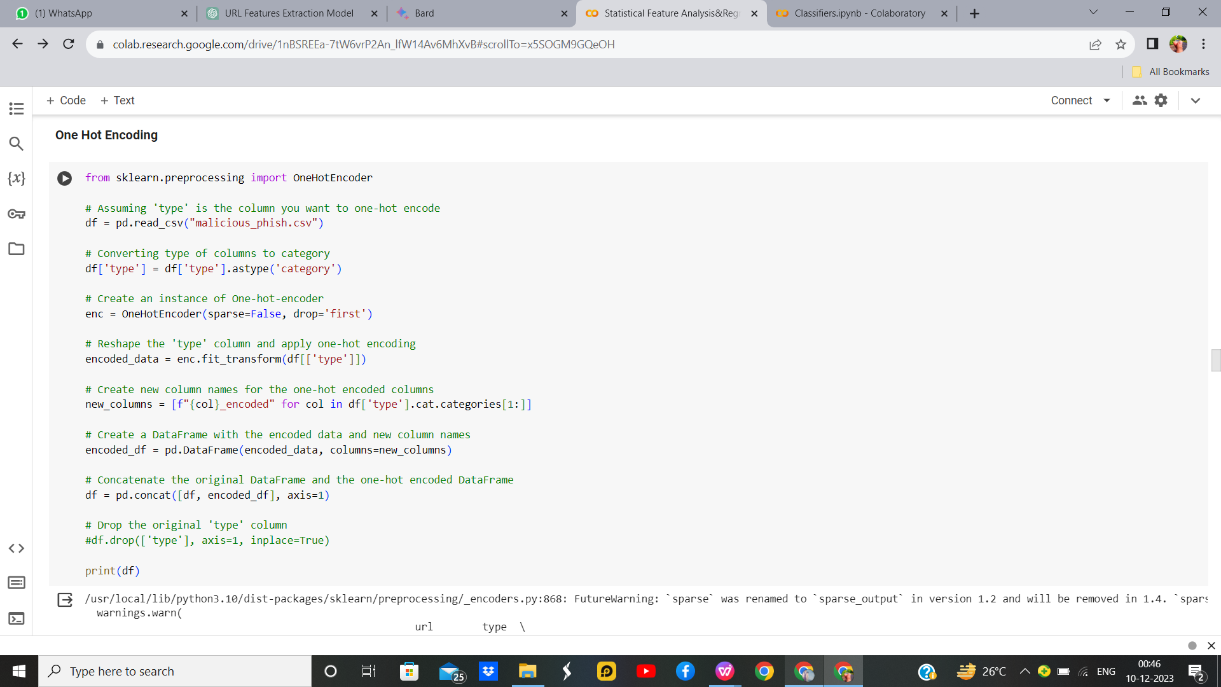
One Hot Encoding
One Hot Encoding is used to represent categorical variables as numerical values in a machine-learning model. Before performing One hot encoding the dataset has a categorical column called Name which has string values and we need to change them to numerical value.

Slide 12
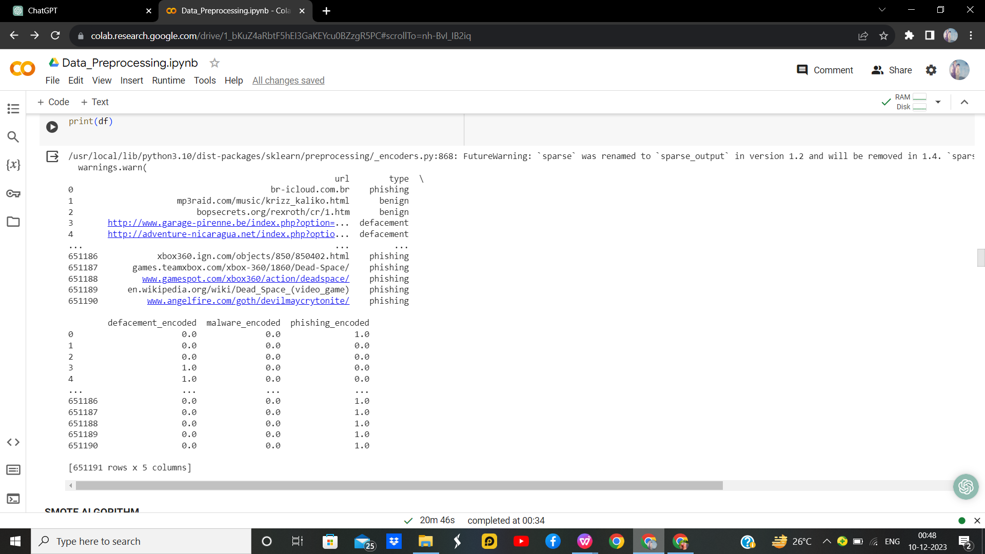
After Performing Onehotencoding the string values of the column [type] are transformed to categorical value [1,0].

Slide 13
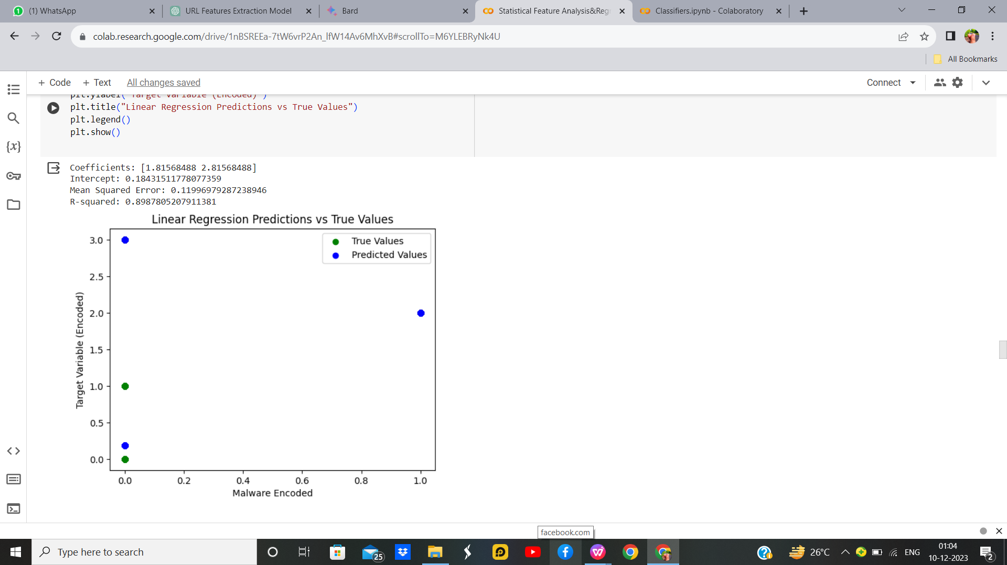
Linear Regression
With Hyperparameter
Parameter Name | Purpose | Value
Test size | To split the dataset into training and testing in a ratio | 0.2
Random State | This parameter sets the seed for the random number generator used by the data splitter. By using a fixed seed, the random splitting process becomes deterministic, allowing for result reproducibility. | 42

Slide 14
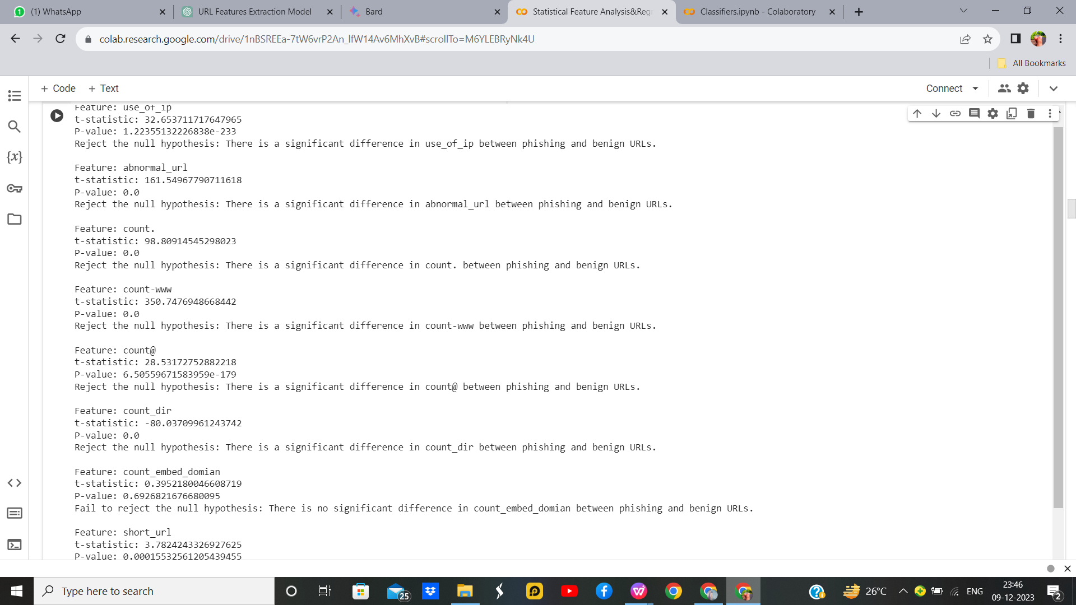
Feature Selection using Statistical Tests
T Test:
A t-test is also used to compare the mean of two given samples like the Z-test. However, It is implemented when the sample size is less than 30. It assumes a normal distribution of the sample. It can also be one-sample or two-sample. The degree of freedom is calculated by n-1 where n is the number of samples.

Slide 15
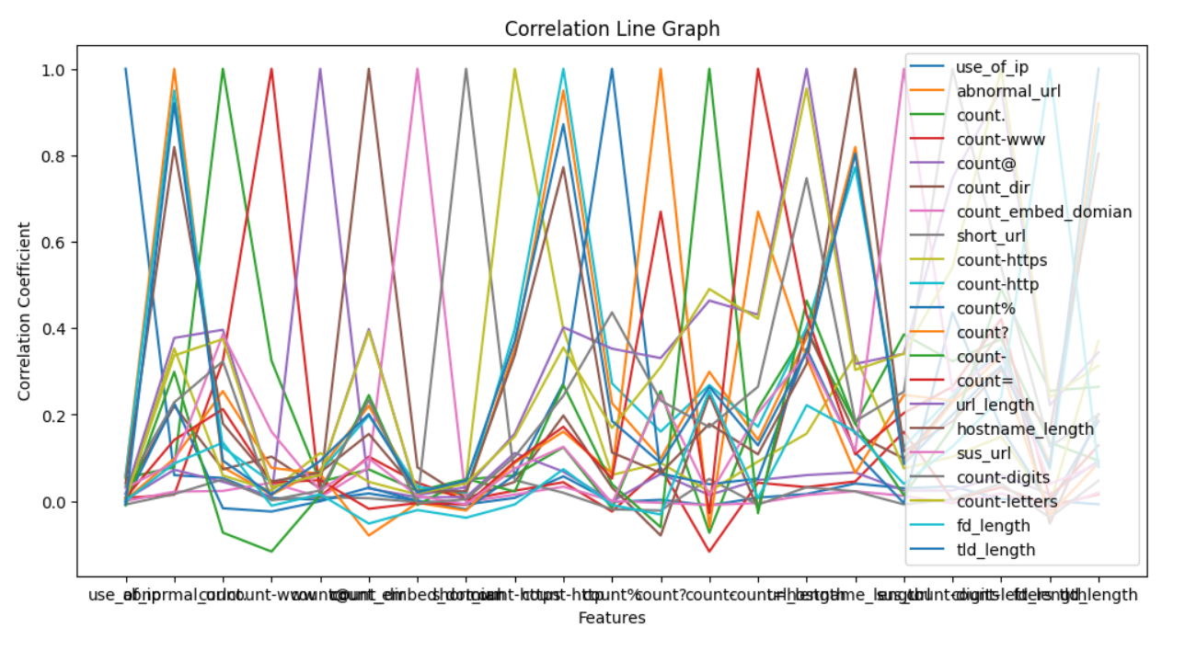
Feature Selection using Statistical Tests(Cont..)
2. Correlation Test:
A correlation test is a metric to evaluate the extent to which variables are associated with one another.

Slide 16
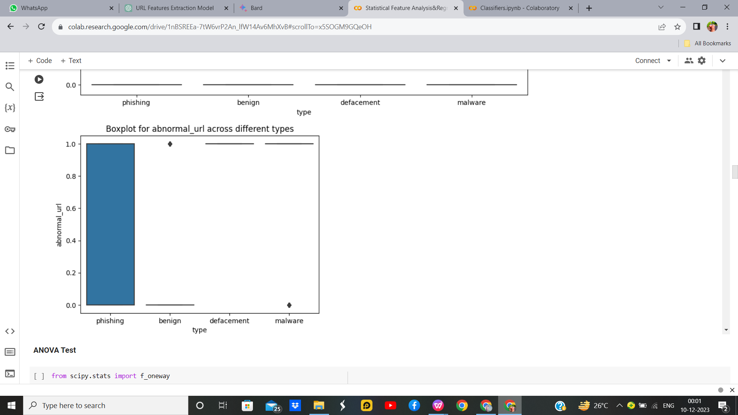
Feature Selection using Statistical Tests(Cont..)
3. ANOVA Test:
ANOVA stands for Analysis of variance. As the name, suggests it uses variance as its parameter to compare multiple independent groups. ANOVA can be one-way ANOVA or two-way ANOVA. One-way ANOVA is applied when there are three or more independent groups of a variable.

Slide 17
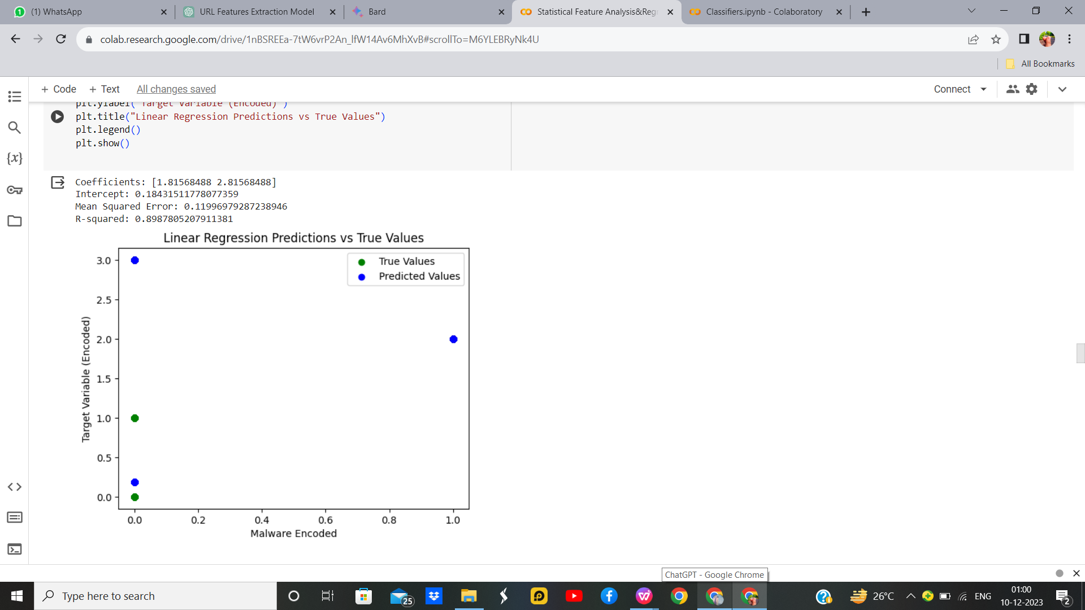
Linear Regression
Without Parameter

Slide 18
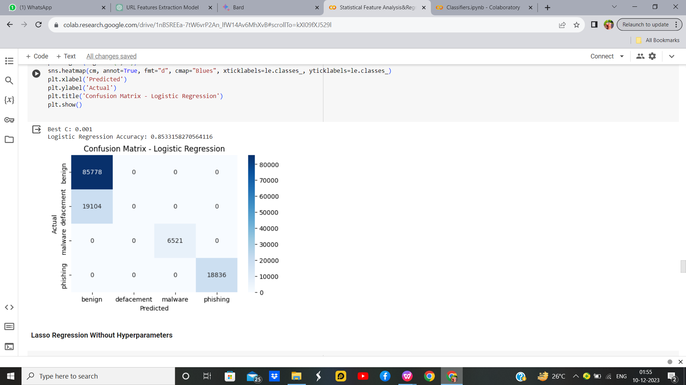
Logistic Regression
With Parameter
Parameter Name | Purpose | Value
Test size | To split the dataset into training and testing in a ratio | 0.2
Random State | This parameter sets the seed for the random number generator used by the data splitter. By using a fixed seed, the random splitting process becomes deterministic, allowing for result reproducibility. | 42
Grid Search | The grid search explores various alpha values using 5-fold cross-validation. | 0.001, 0.01, 0.1, 1, 10, 100, 1000

Slide 19
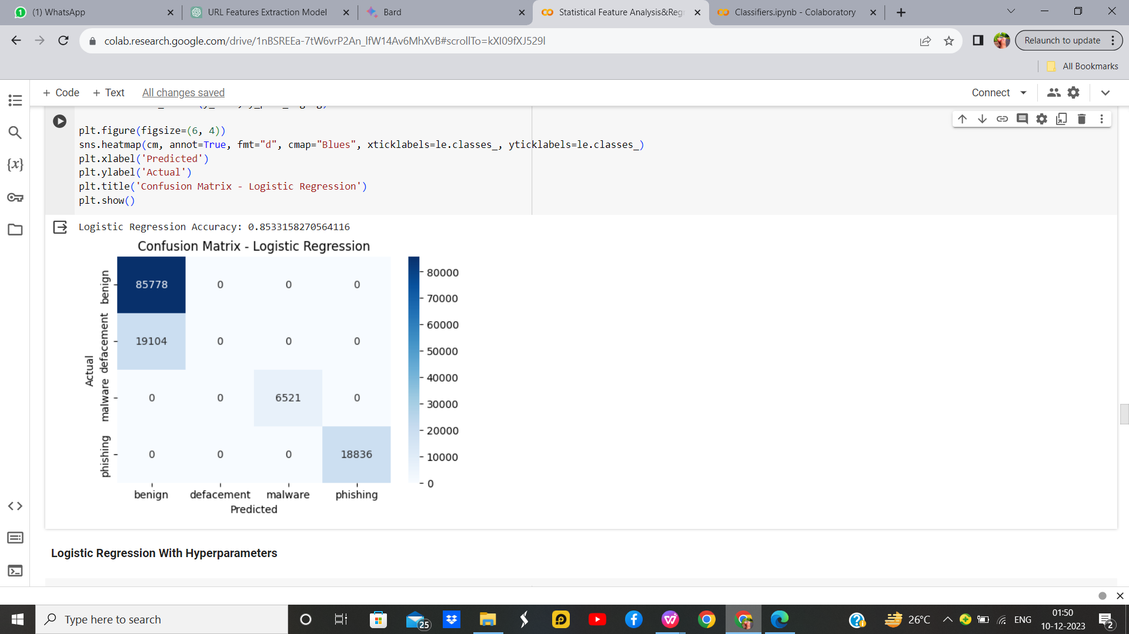
Logistic Regression
Without Parameter

Slide 20
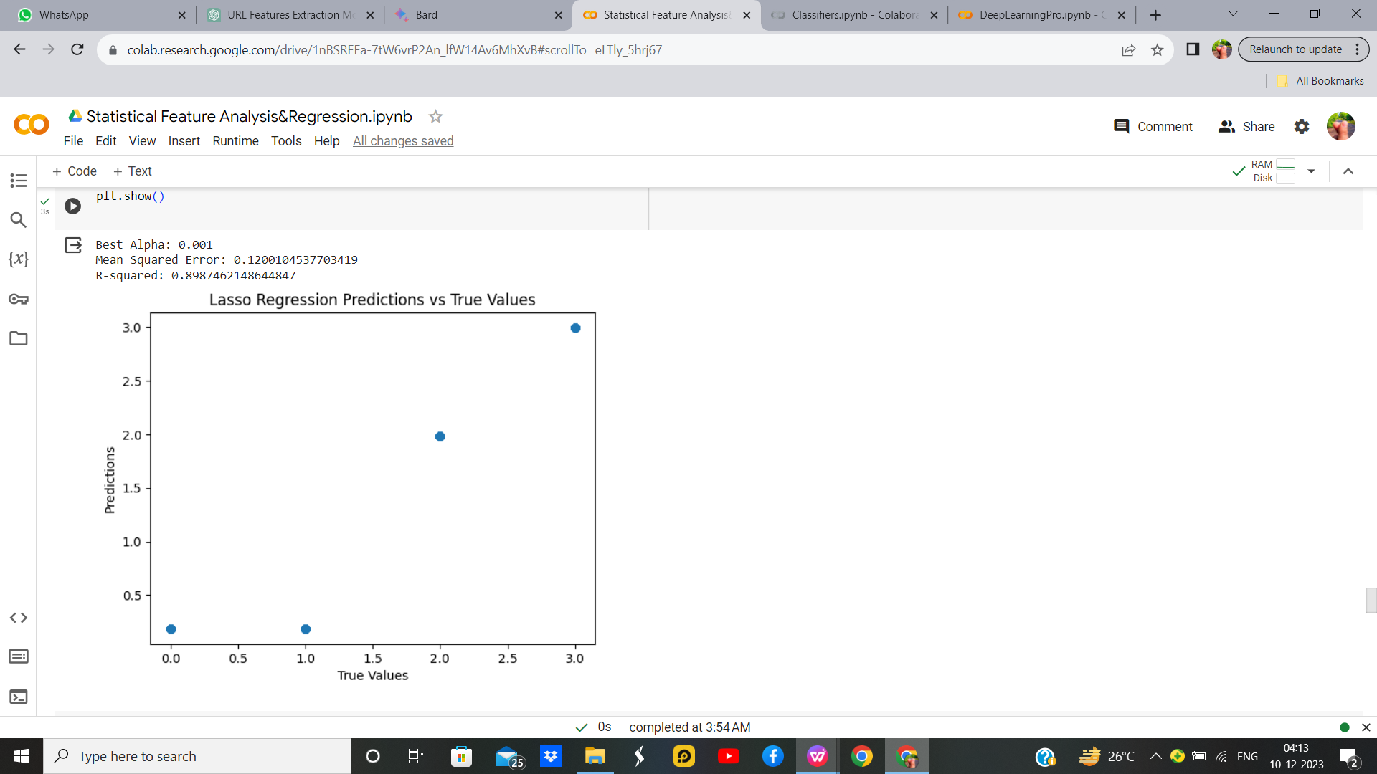
Lasso Regression With Hyperparameter
Parameter Name | Purpose | Value
Test size | To split the dataset into training and testing in a ratio | 0.2
Random State | This parameter sets the seed for the random number generator used by the data splitter. By using a fixed seed, the random splitting process becomes deterministic, allowing for result reproducibility. | 42
Alpha | The regularization parameter controls the amount of shrinkage applied to the coefficients of the model | 0.01
Grid Search | The grid search explores various alpha values using 5-fold cross-validation. | 0.001, 0.01, 0.1, 1, 10, 100, 1000

Slide 21

Lasso Regression
Without Hyperparameter

Slide 22
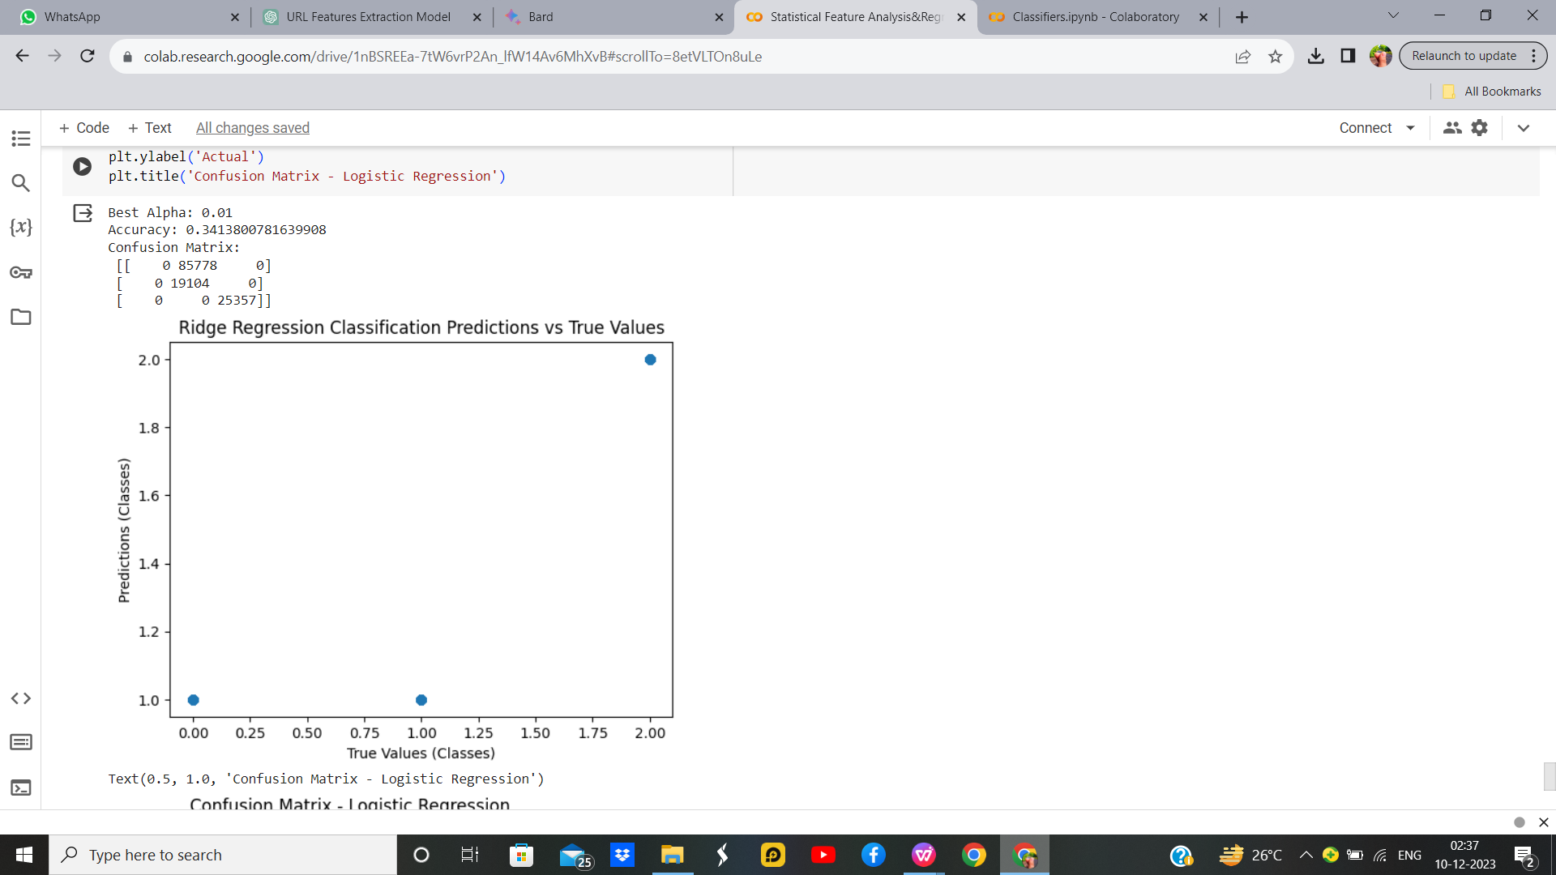
Ridge Regression
With Hyper Parameter
Parameter Name | Purpose | Value
Test size | To split the dataset into training and testing in a ratio | 0.2
Random State | This parameter sets the seed for the random number generator used by the data splitter. By using a fixed seed, the random splitting process becomes deterministic, allowing for result reproducibility. | 42
Alpha | The regularization parameter controls the amount of shrinkage applied to the coefficients of the model | 0.01
Grid Search CV | The grid search explores various alpha values using 5-fold cross-validation. | 0.001, 0.01, 0.1, 1, 10, 100, 1000

Slide 23
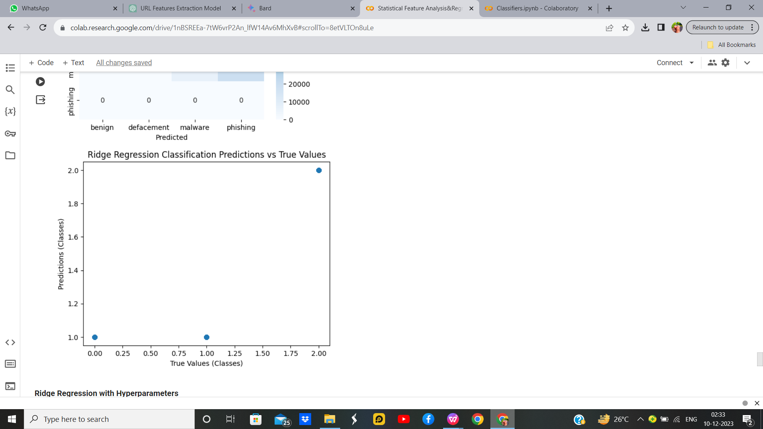
Ridge Regression
Without Hyper parameter

Slide 24
Evaluation Parameters for best models of each type of regression
Model | MSE | Accuracy | Precision | F1 | Recall
Linear | 0.1199 | 0.85 | 0.88 | 0.84 | 0.85
Logistic | - | 0.853 | 0.88 | 0.84 | 0.85
Ridge | 0.600 | 0.34 | 0.73 | 0.67 | 0.71
Lasso | 0.1200 | 0.85 | 0.88 | 0.84 | 0.85

Slide 25
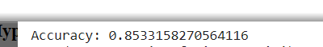
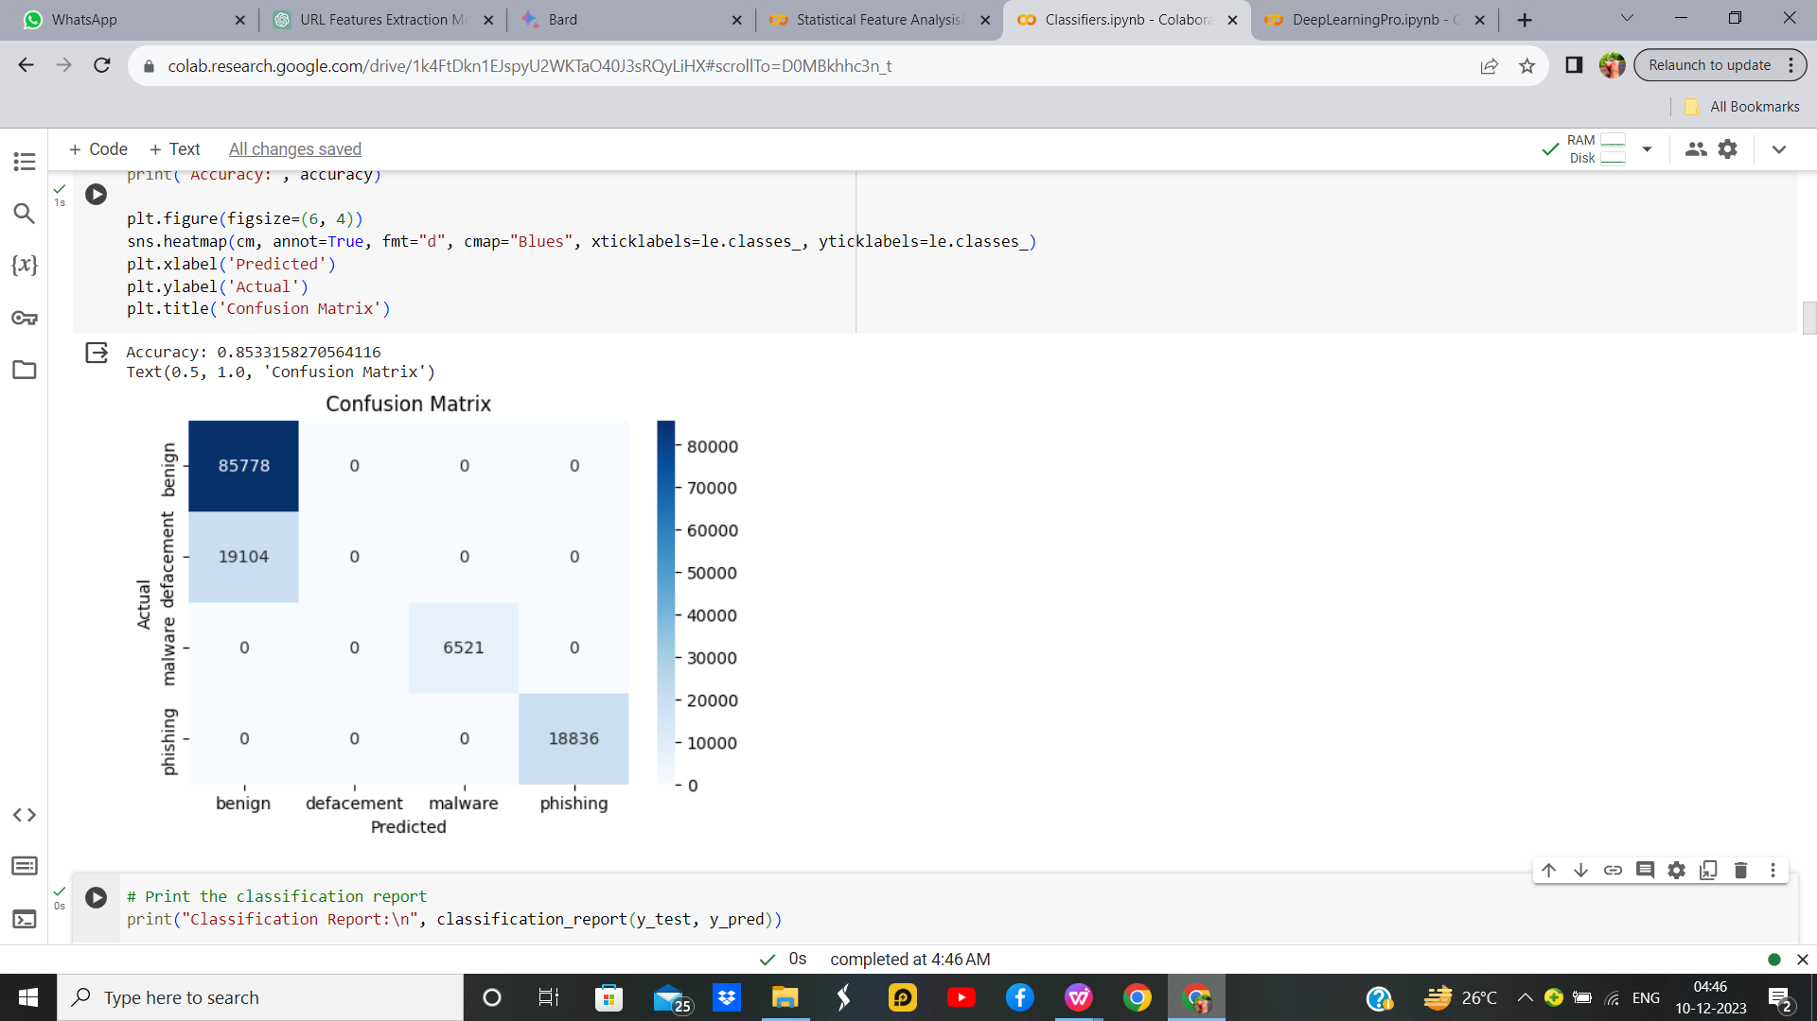
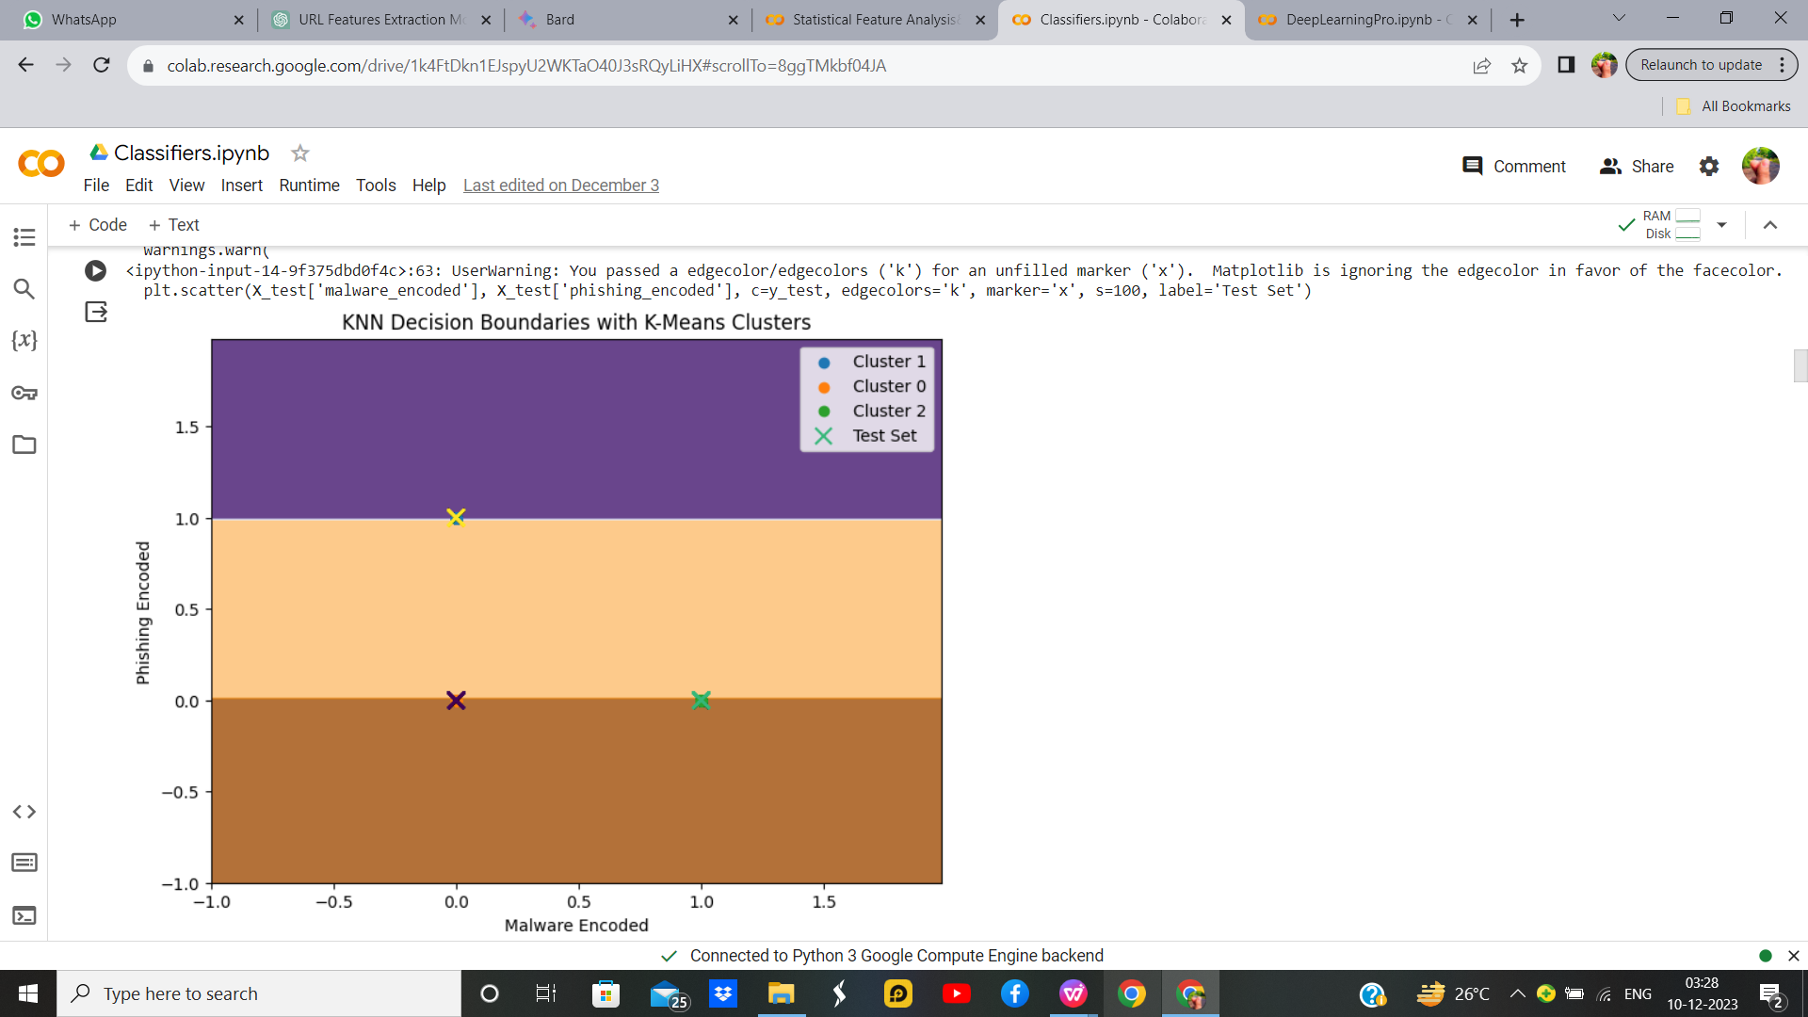
K-Means With KNN
K-Means With KNN With Hyper parameter
Parameter Name | Purpose | Value
Test size | To split the dataset into training and testing in a ratio | 0.2
Random State | This parameter sets the seed for the random number generator used by the data splitter. By using a fixed seed, the random splitting process becomes deterministic, allowing for result reproducibility. | 42
No. of Clusters | Number of the centroid which will be formed | 2
Grid Search CV | The grid search explores various alpha values using 5-fold cross-validation. | n_neighbors: 5, 5, 7, 9

Slide 26
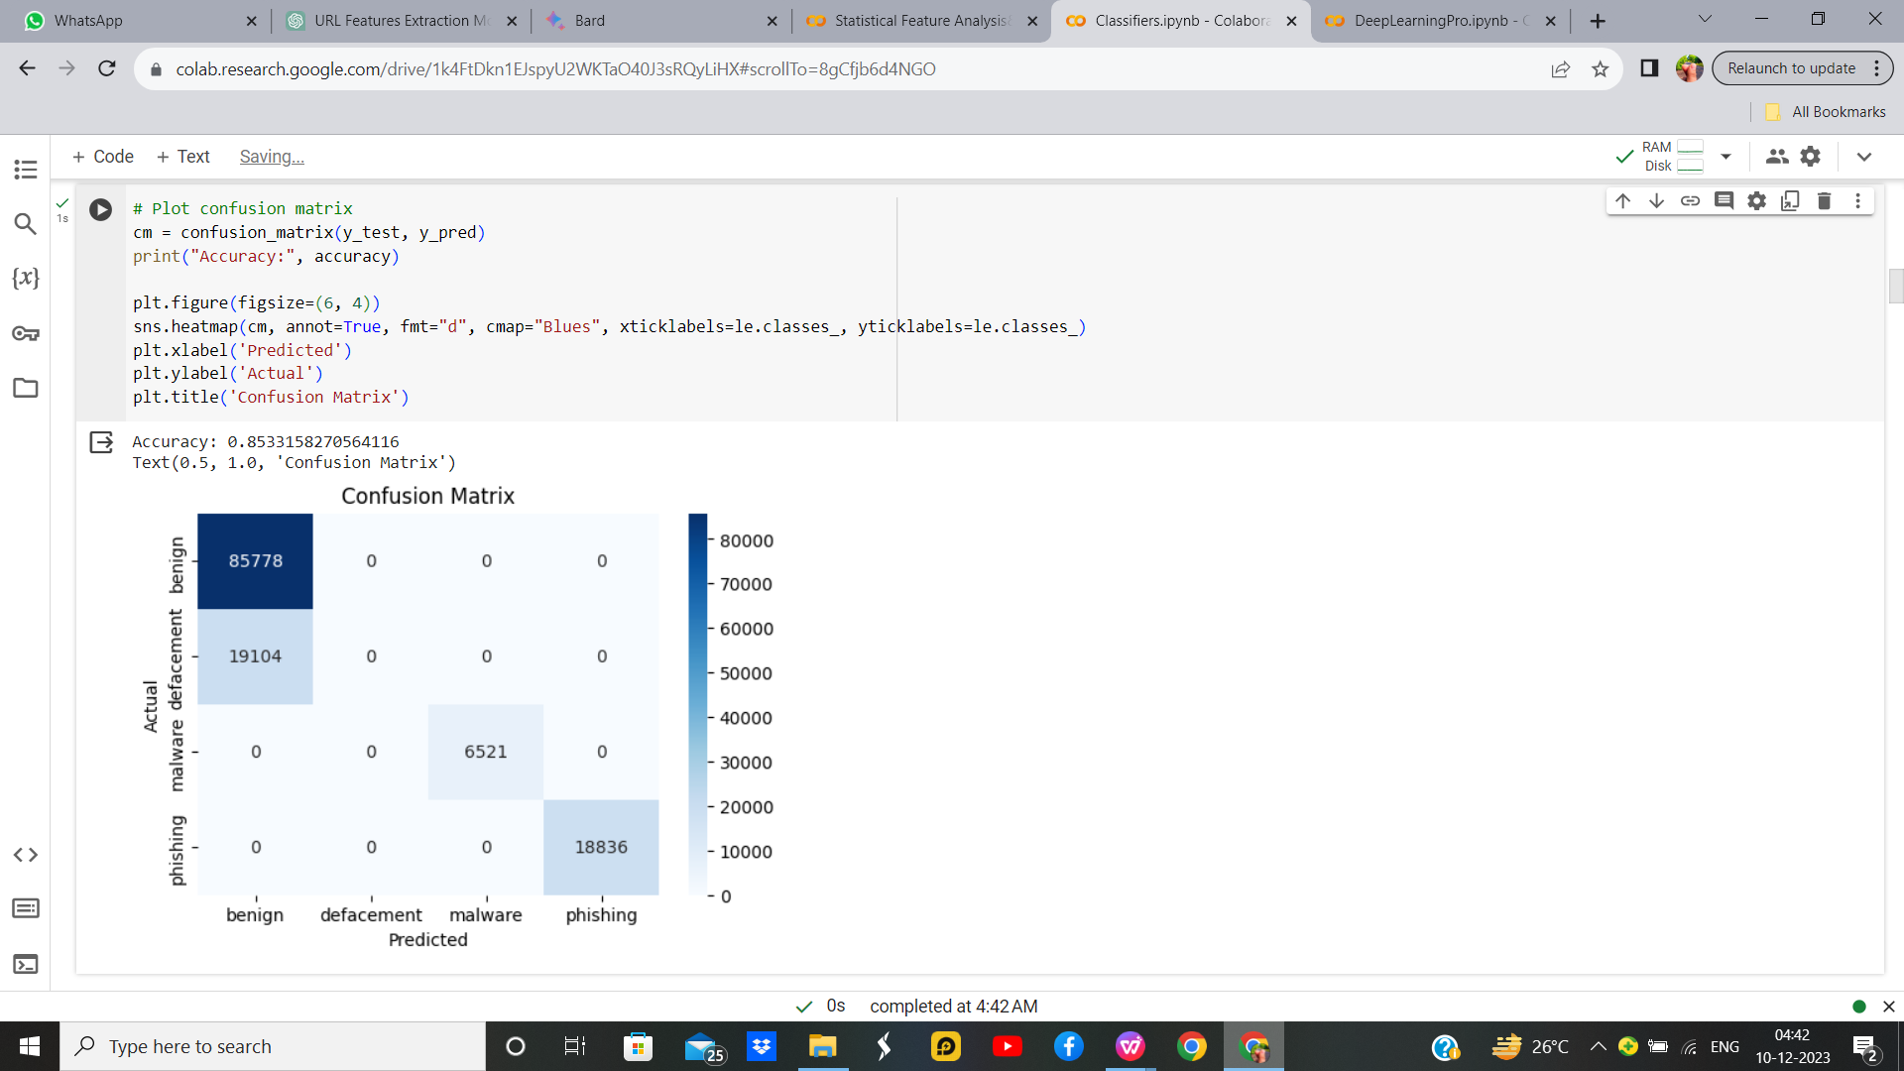
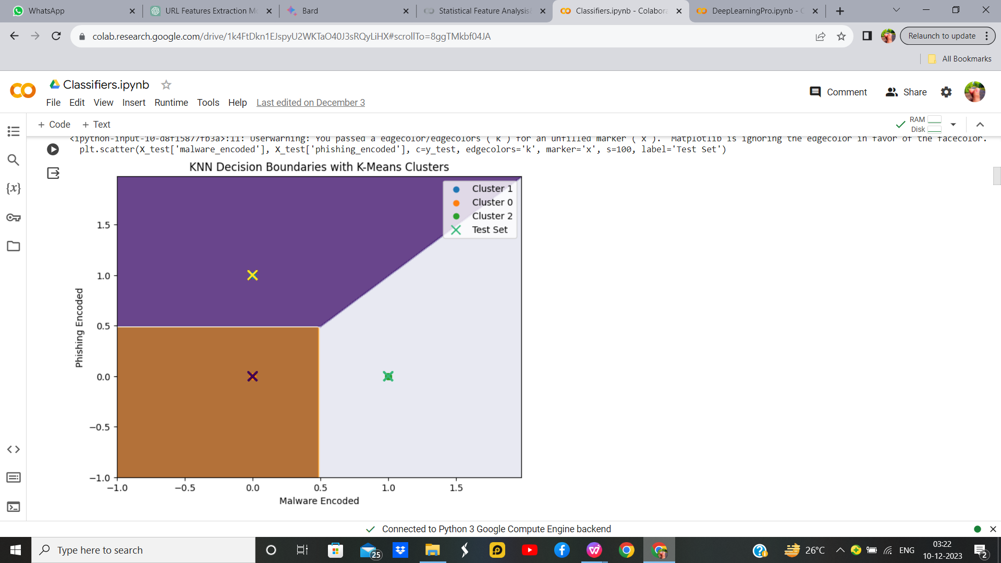
K-Means With KNN without Hyper parameter

Slide 27
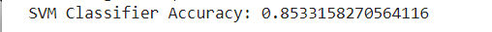
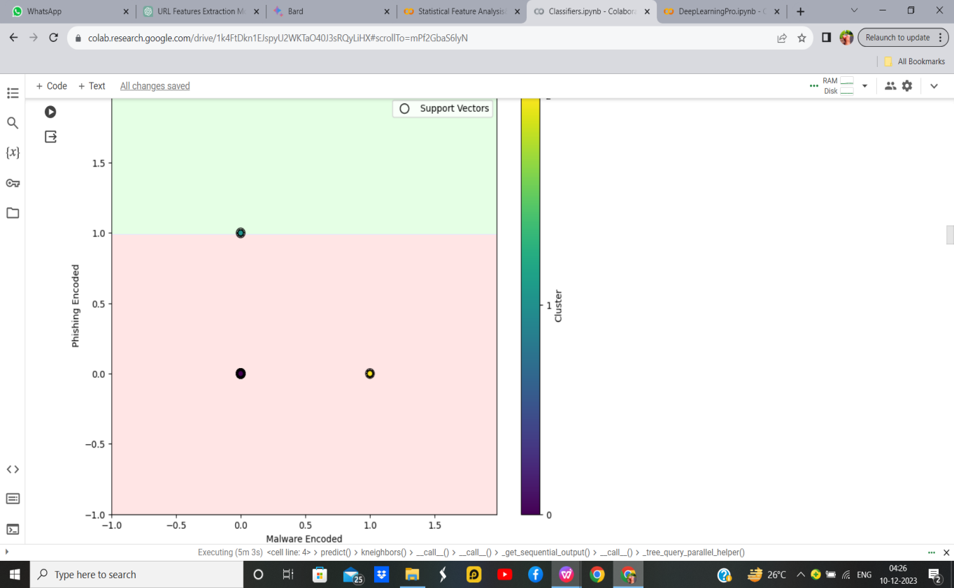
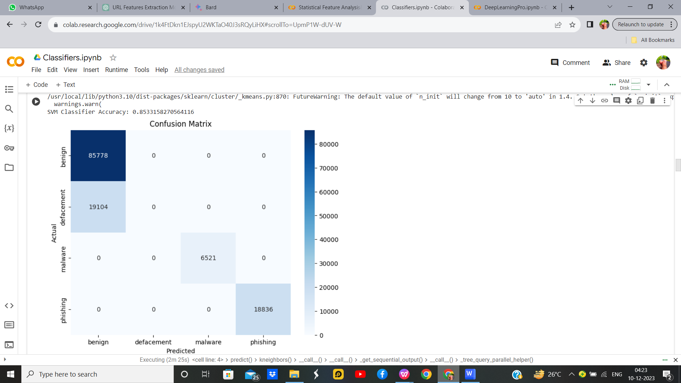
K-Means with SVM
K-Means with SVM with Hyperparameter
Parameter Name | Purpose | Value
Test size | To split the dataset into training and testing in a ratio | 0.2
Random State | This parameter sets the seed for the random number generator used by the data splitter. By using a fixed seed, the random splitting process becomes deterministic, allowing for result reproducibility. | 42
Kernel | kernel is a function that computes the dot product of two data points in a transformed feature space. | Linear
Grid Search CV | The grid search explores various alpha values using 5-fold cross-validation. | 0.1, 1, 10

Slide 28
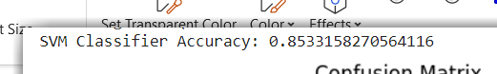
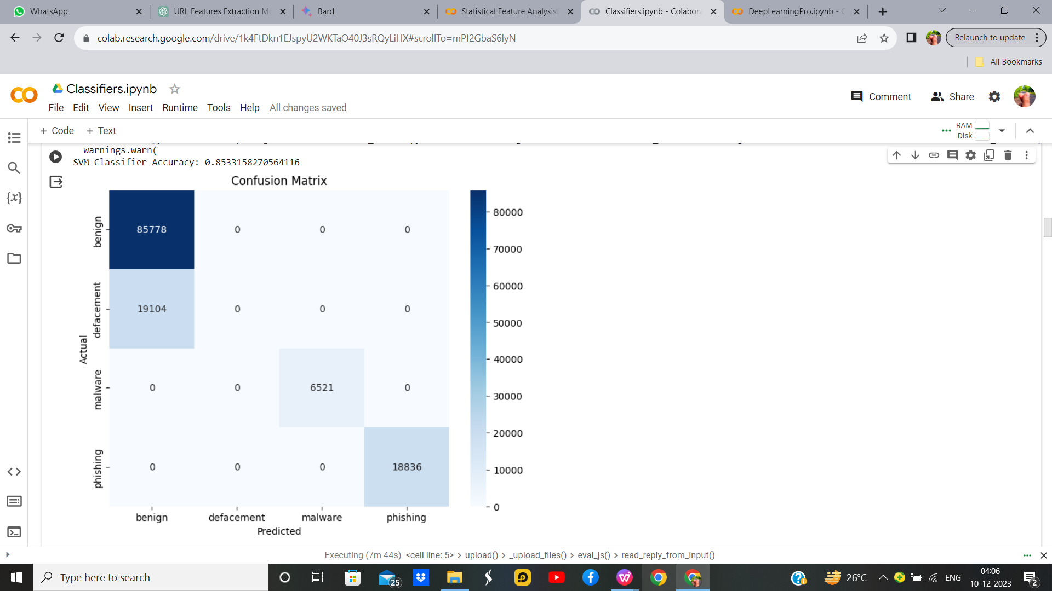
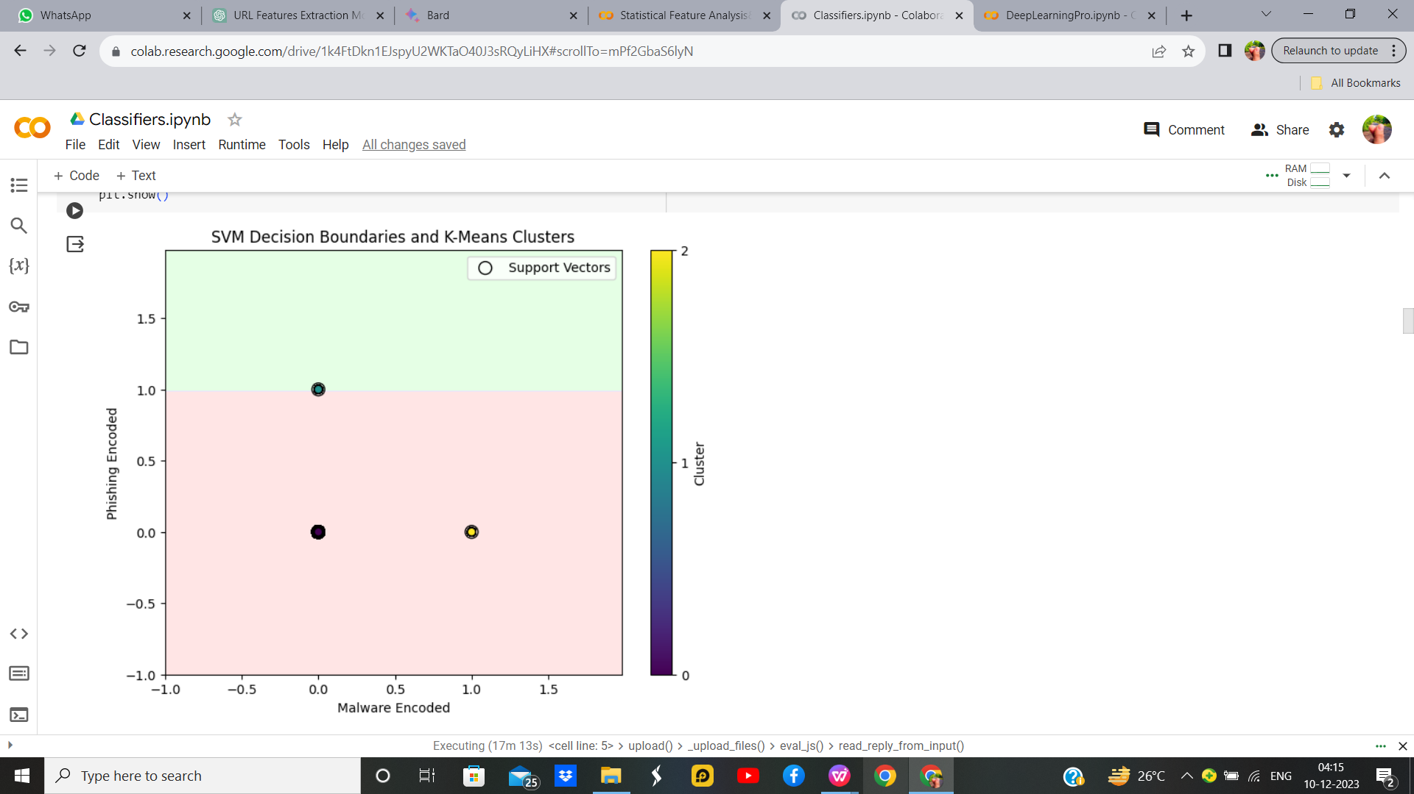
K-Means with SVM without Hyperparameter Output

Slide 29
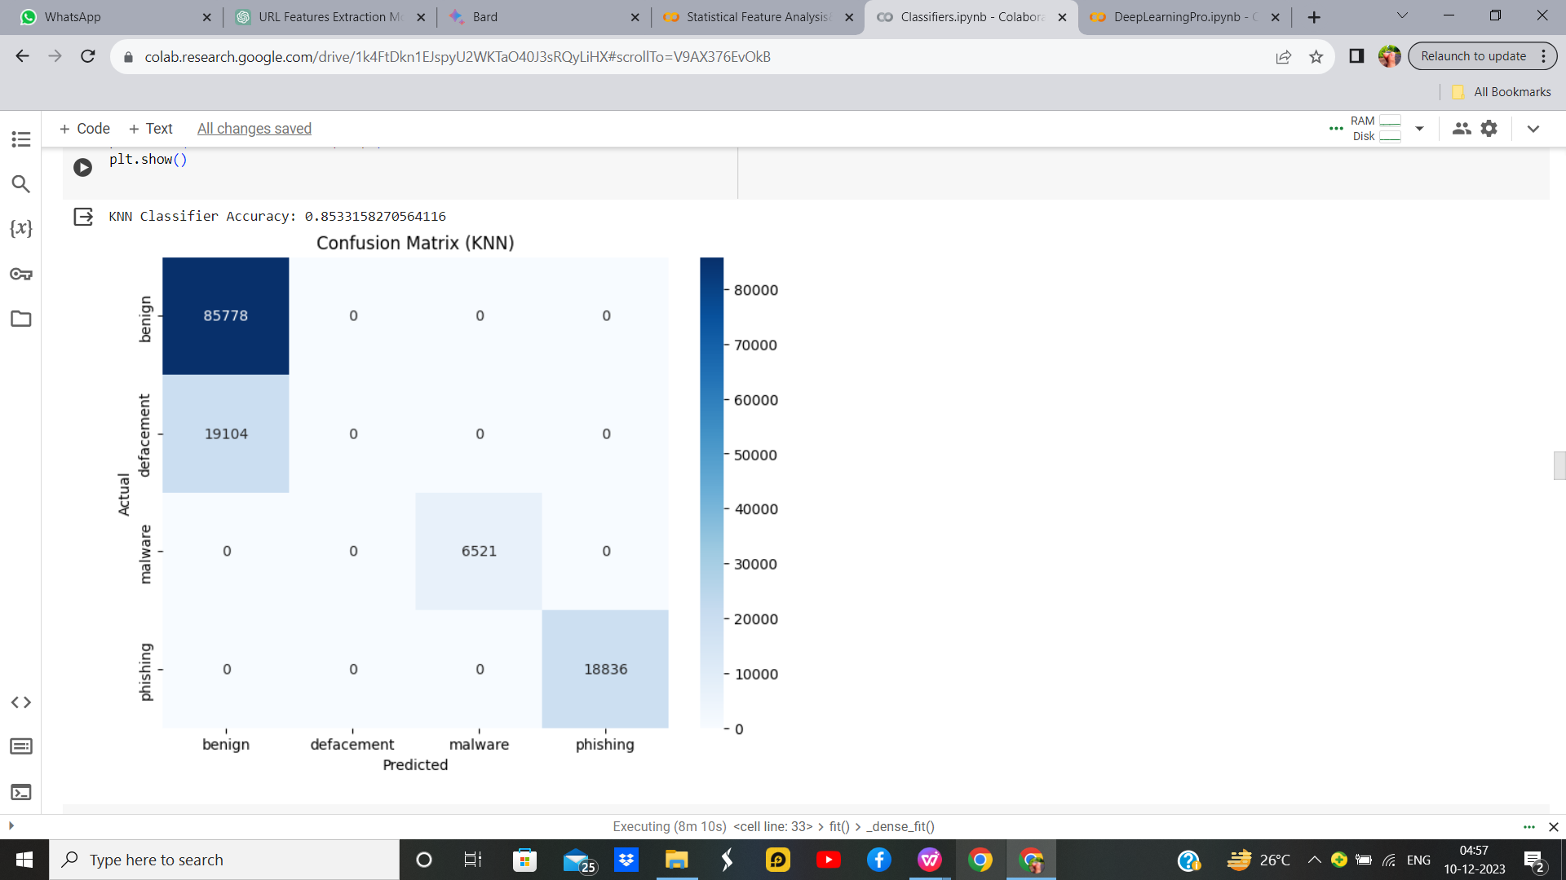
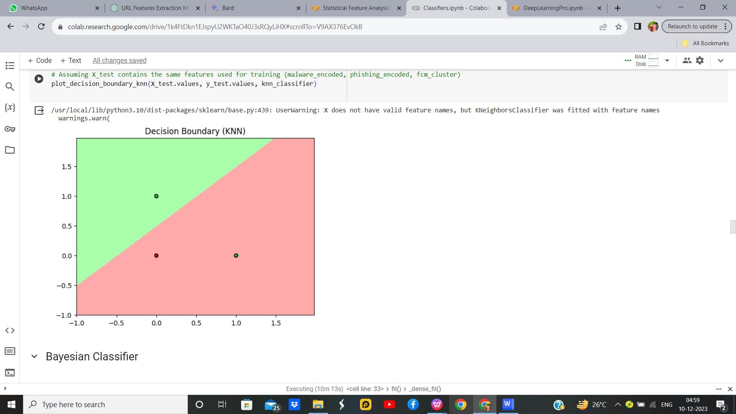
FuzzyC-Means with KNN with Hyperparameter
Parameter Name | Purpose | Value
Test size | To split the dataset into training and testing in a ratio | 0.2
Random State | This parameter sets the seed for the random number generator used by the data splitter. By using a fixed seed, the random splitting process becomes deterministic, allowing for result reproducibility. | 42
No. of Clusters | Number of the centroid which will be formed | 2
Grid Search CV | The grid search explores various alpha values using 5-fold cross-validation. | n_neighbors: 3, 5, 7, 9

Slide 30
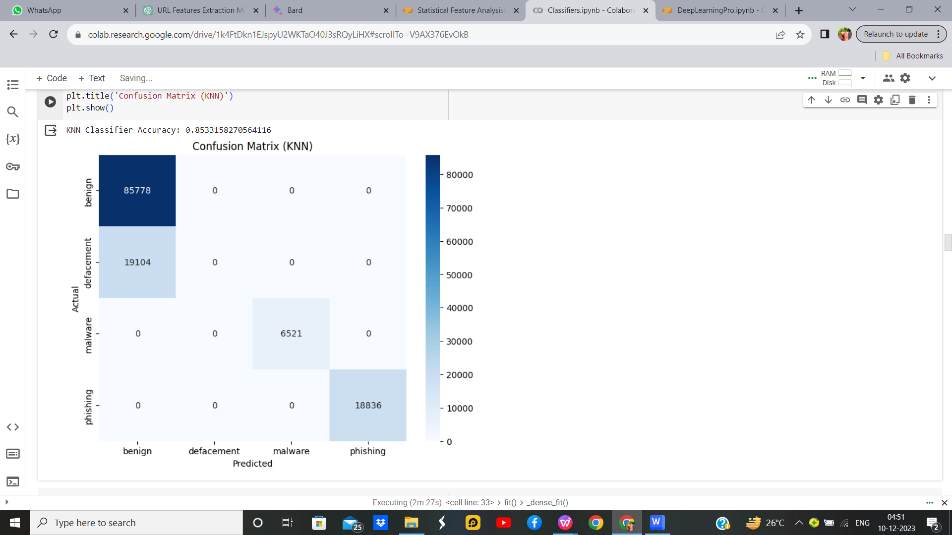
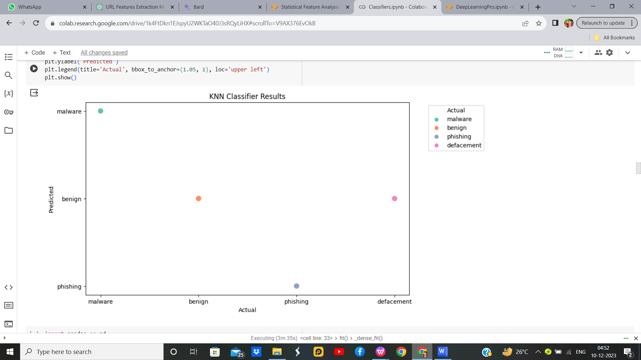
FuzzyC-Means with KNN without Hyperparameter

Slide 31
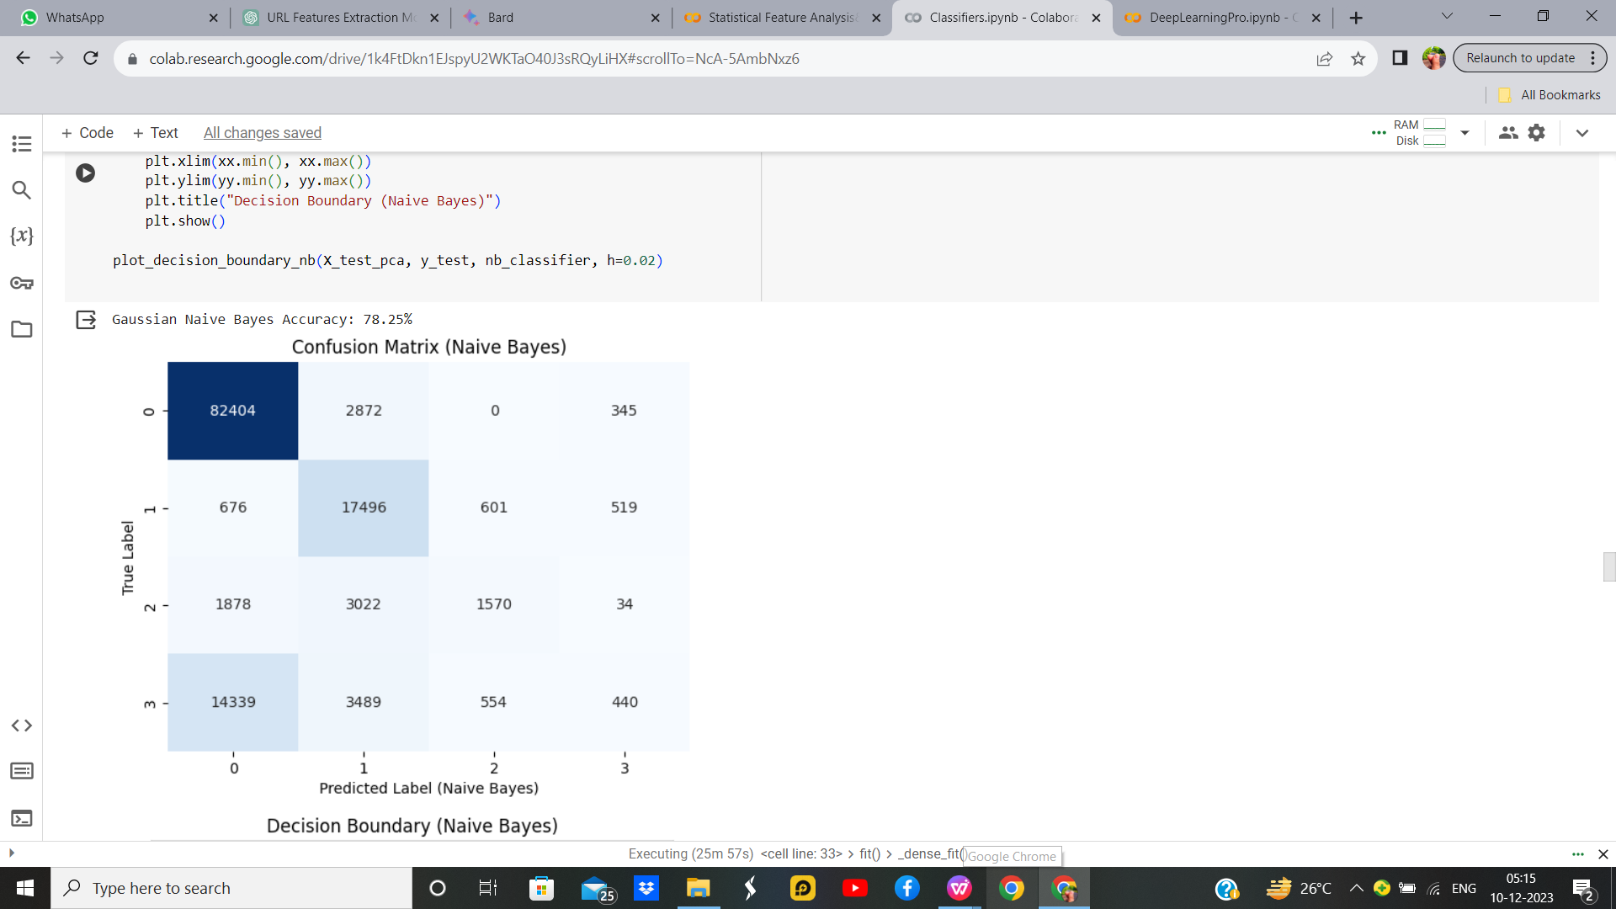
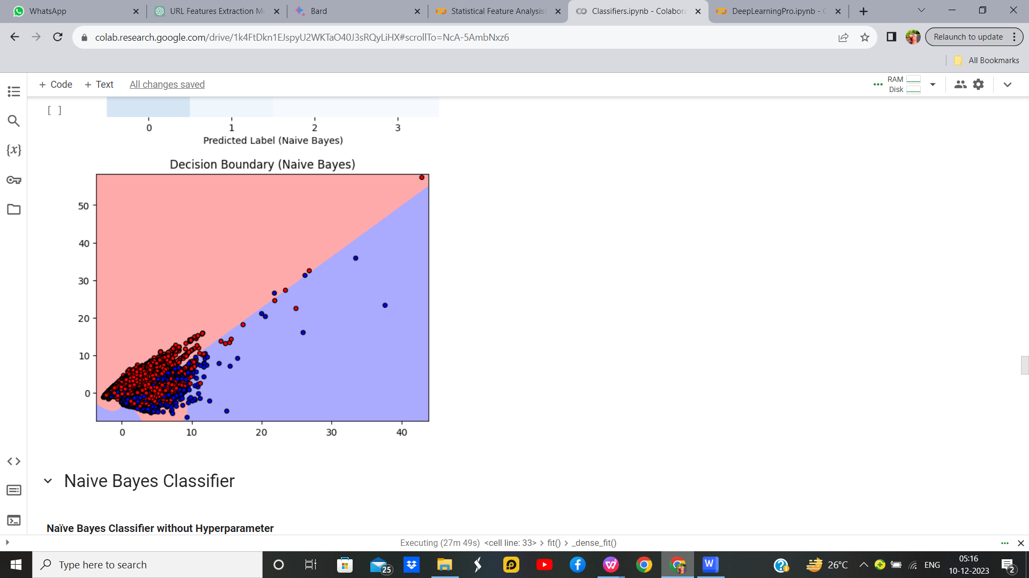
Bayesian Classifier With Hyperparameter
Parameter Name | Purpose | Value
Test size | To split the dataset into training and testing in a ratio | 0.2
Random State | This parameter sets the seed for the random number generator used by the data splitter. By using a fixed seed, the random splitting process becomes deterministic, allowing for result reproducibility. | 5
Grid Search CV | The grid search explores various alpha values using 5-fold cross-validation. | np.logspace(0, -9, num=100)

Slide 32
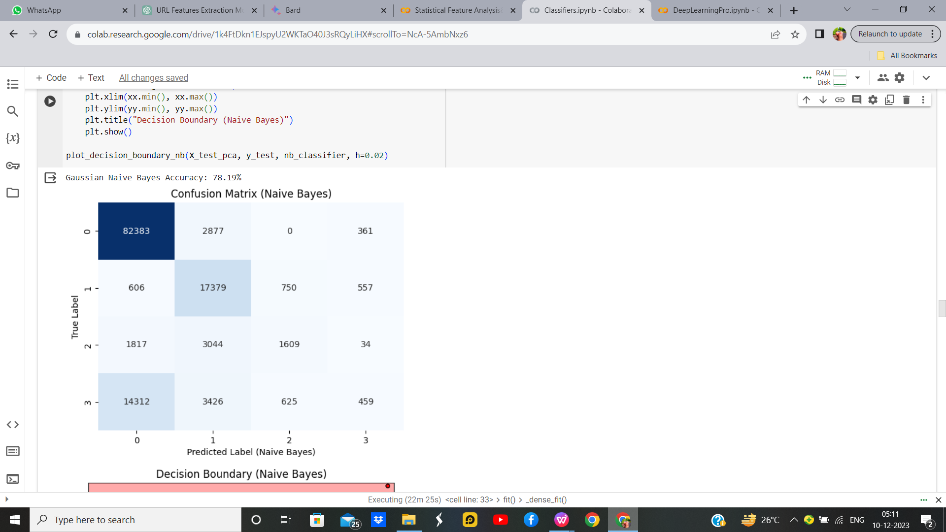
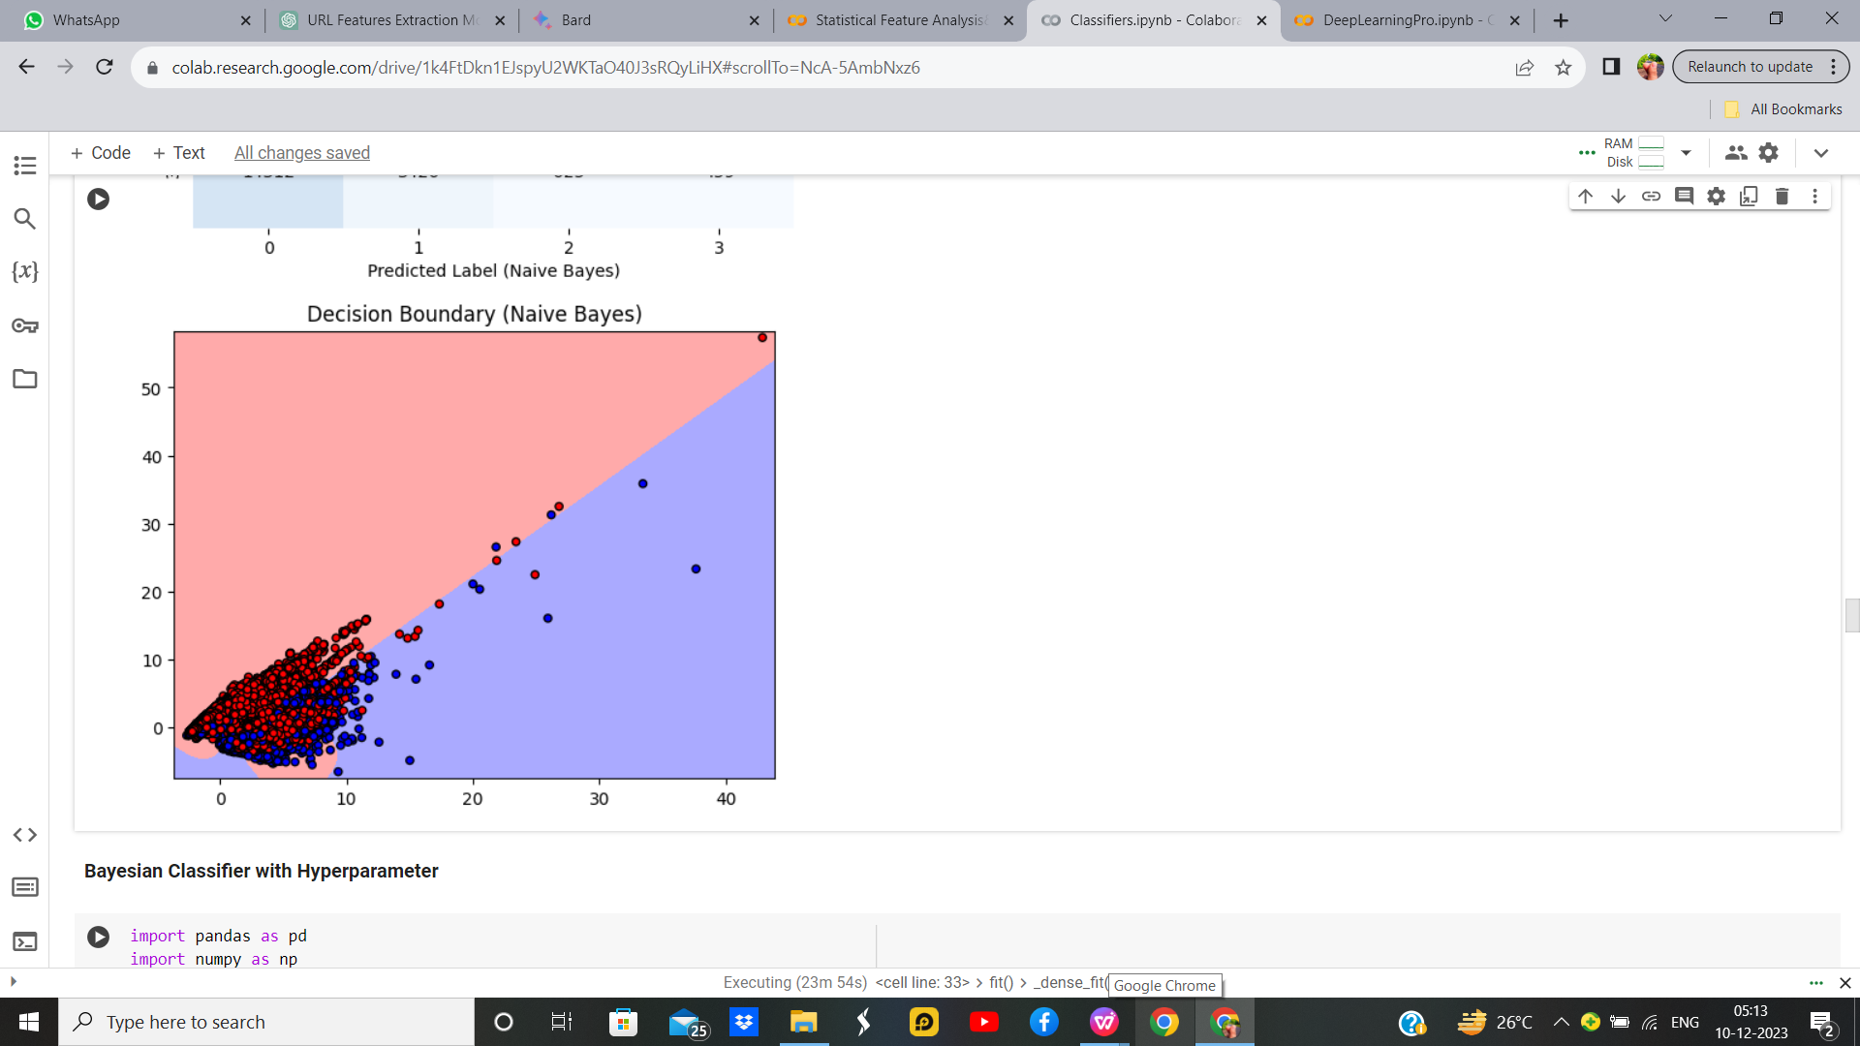
Bayesian Classifier without hyperparameter

Slide 33
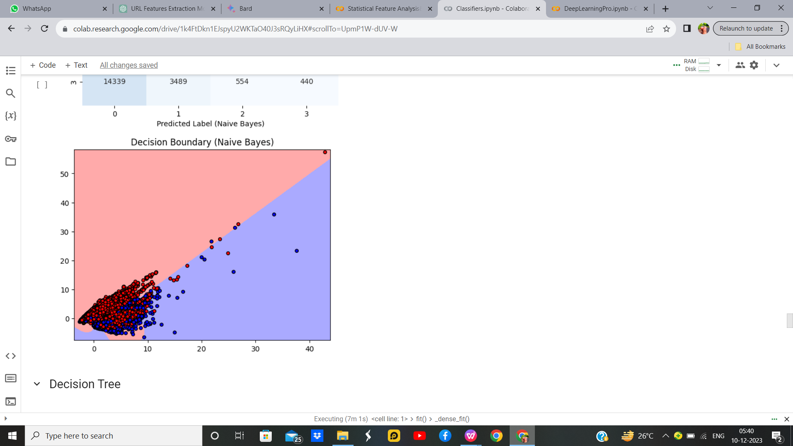
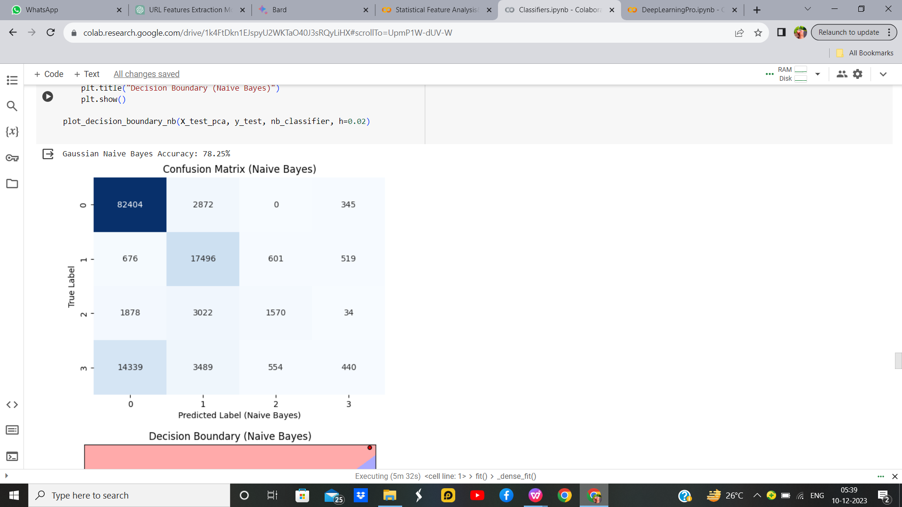
Naive Bayes Classifier with Hyper parameter
Parameter Name | Purpose | Value
Test size | To split the dataset into training and testing in a ratio | 0.2
Random State | This parameter sets the seed for the random number generator used by the data splitter. By using a fixed seed, the random splitting process becomes deterministic, allowing for result reproducibility. | 5
Grid Search CV | The grid search explores various alpha values using 5-fold cross-validation. | np.logspace(0, -9, num=100)

Slide 34
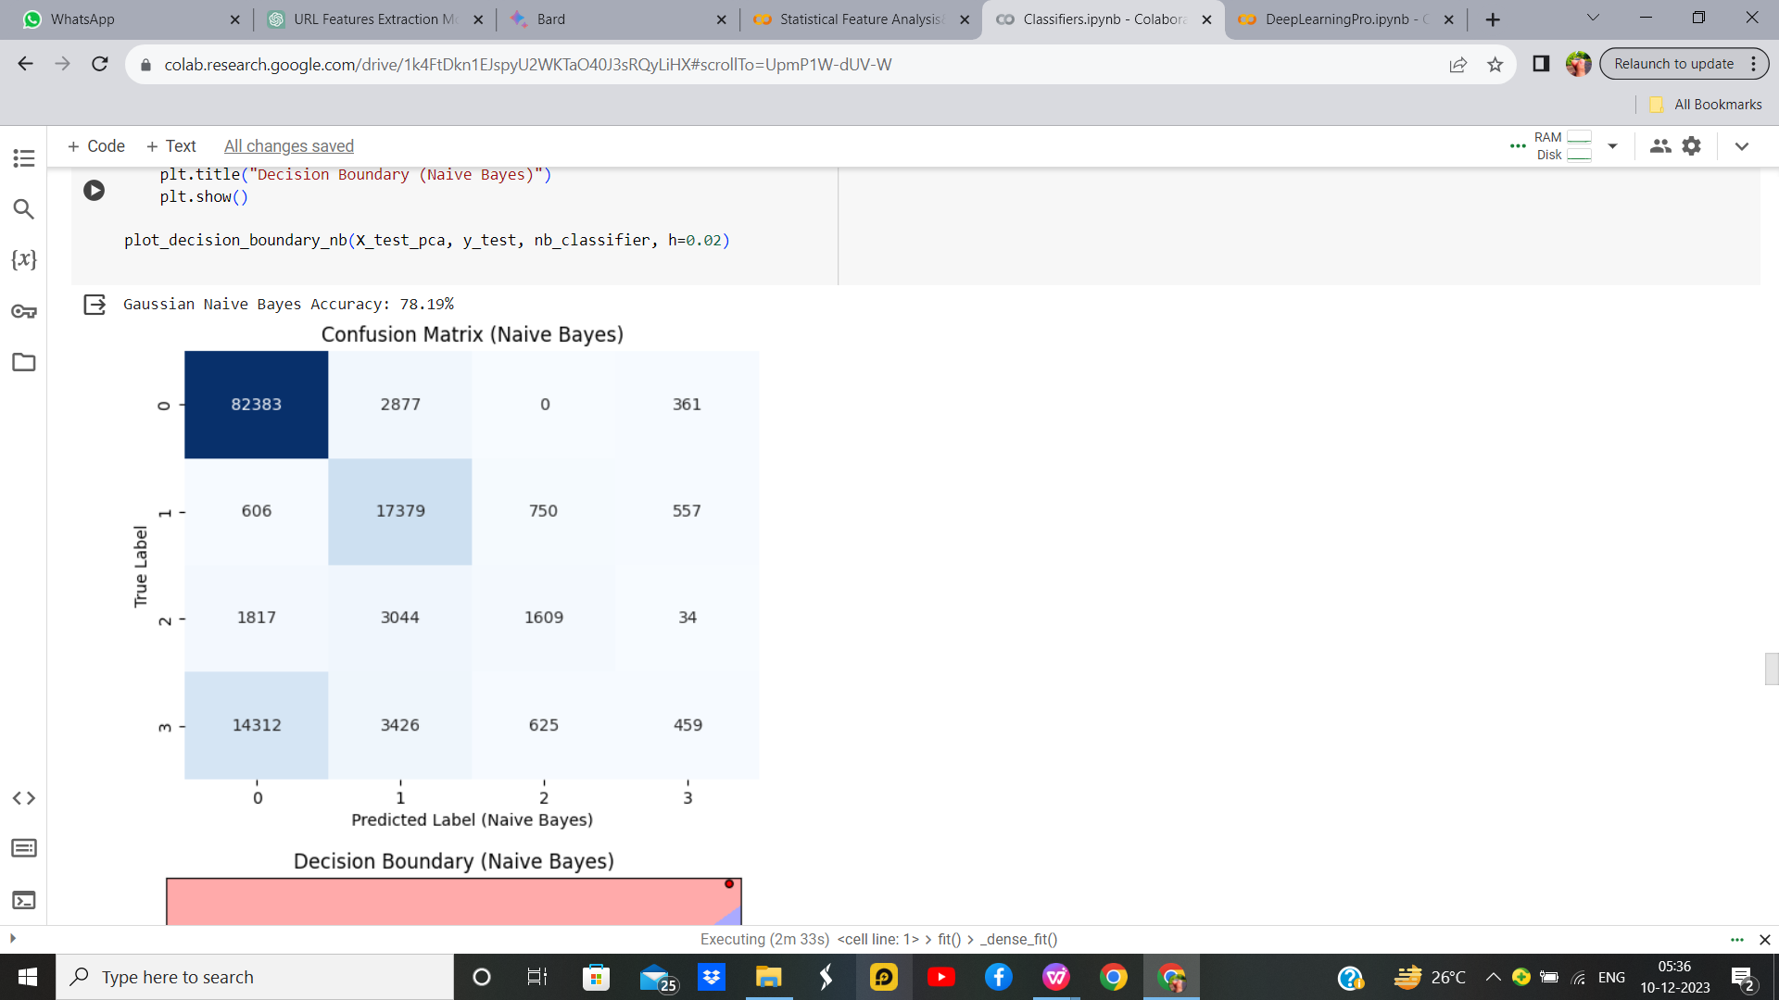
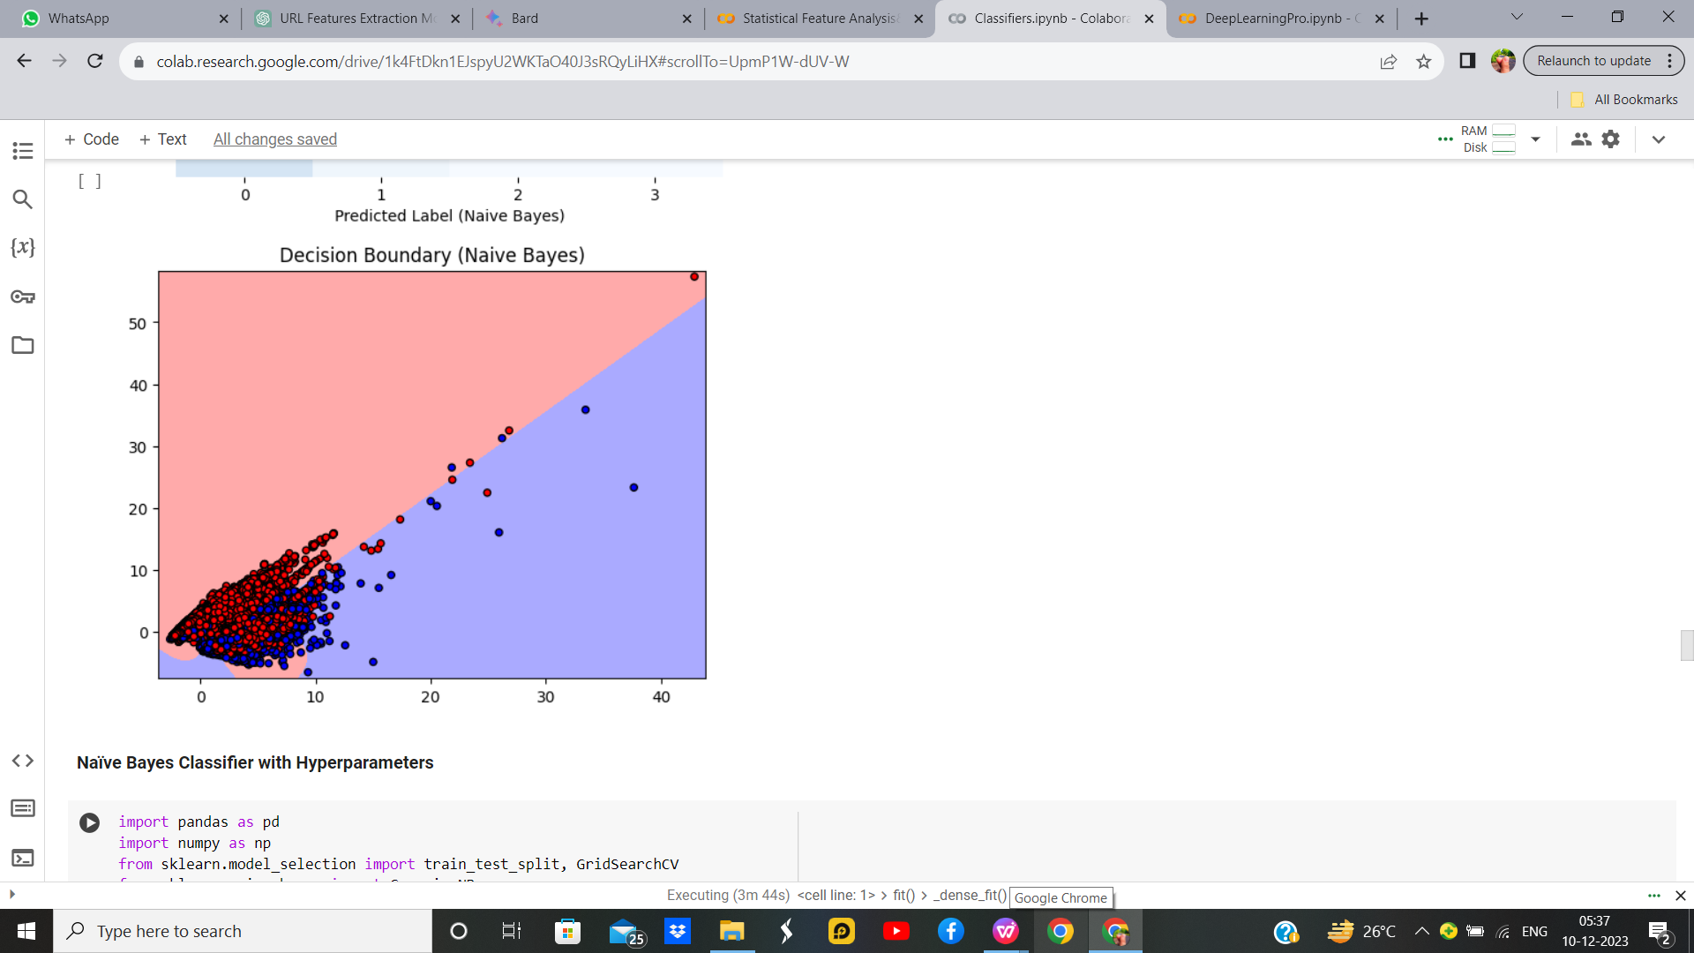
Naive Bayes Classifier without Hyper parameter

Slide 35
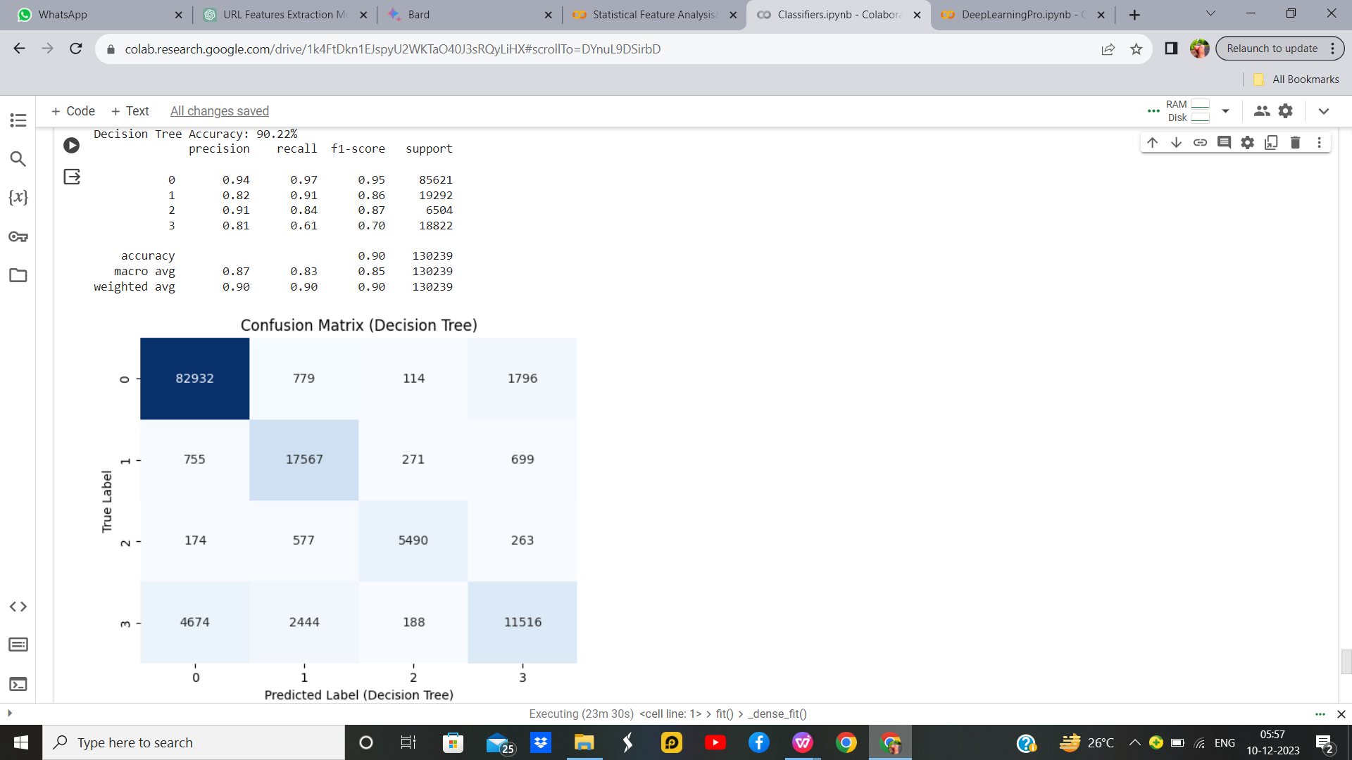
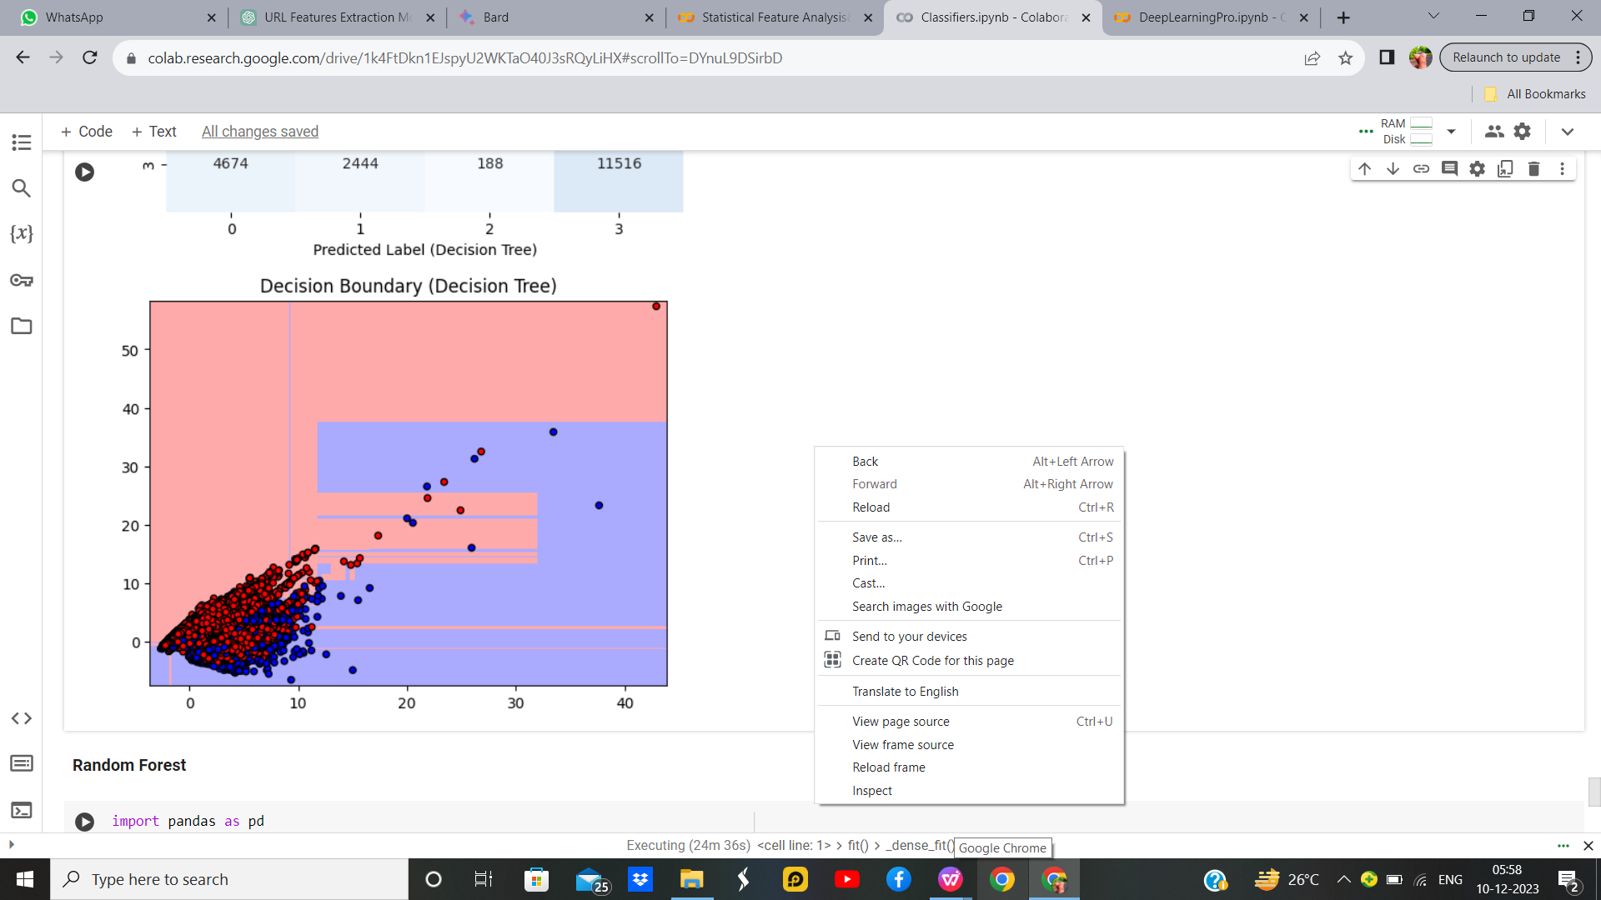
Decision Tree with Hyper parameter
Parameter Name | Purpose | Value
Test size | To split the dataset into training and testing in a ratio | 0.2
Random State | This parameter sets the seed for the random number generator used by the data splitter. By using a fixed seed, the random splitting process becomes deterministic, allowing for result reproducibility. | 42
Grid Search CV | The grid search explores various alpha values using 5-fold cross-validation. | 'criterion': ['gini', 'entropy'], 'max_depth': [None, 10, 20, 30, 40, 50], 'min_samples_split': [2, 5, 10], 'min_samples_leaf': [1, 2, 4]

Slide 36
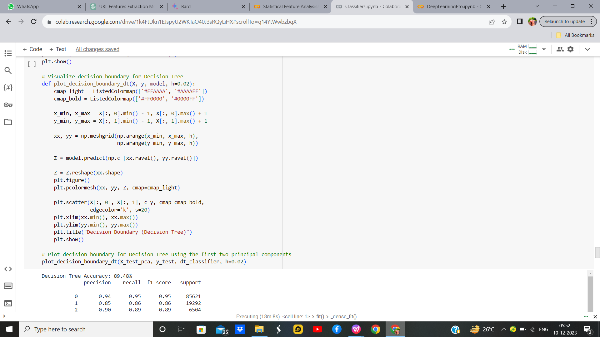
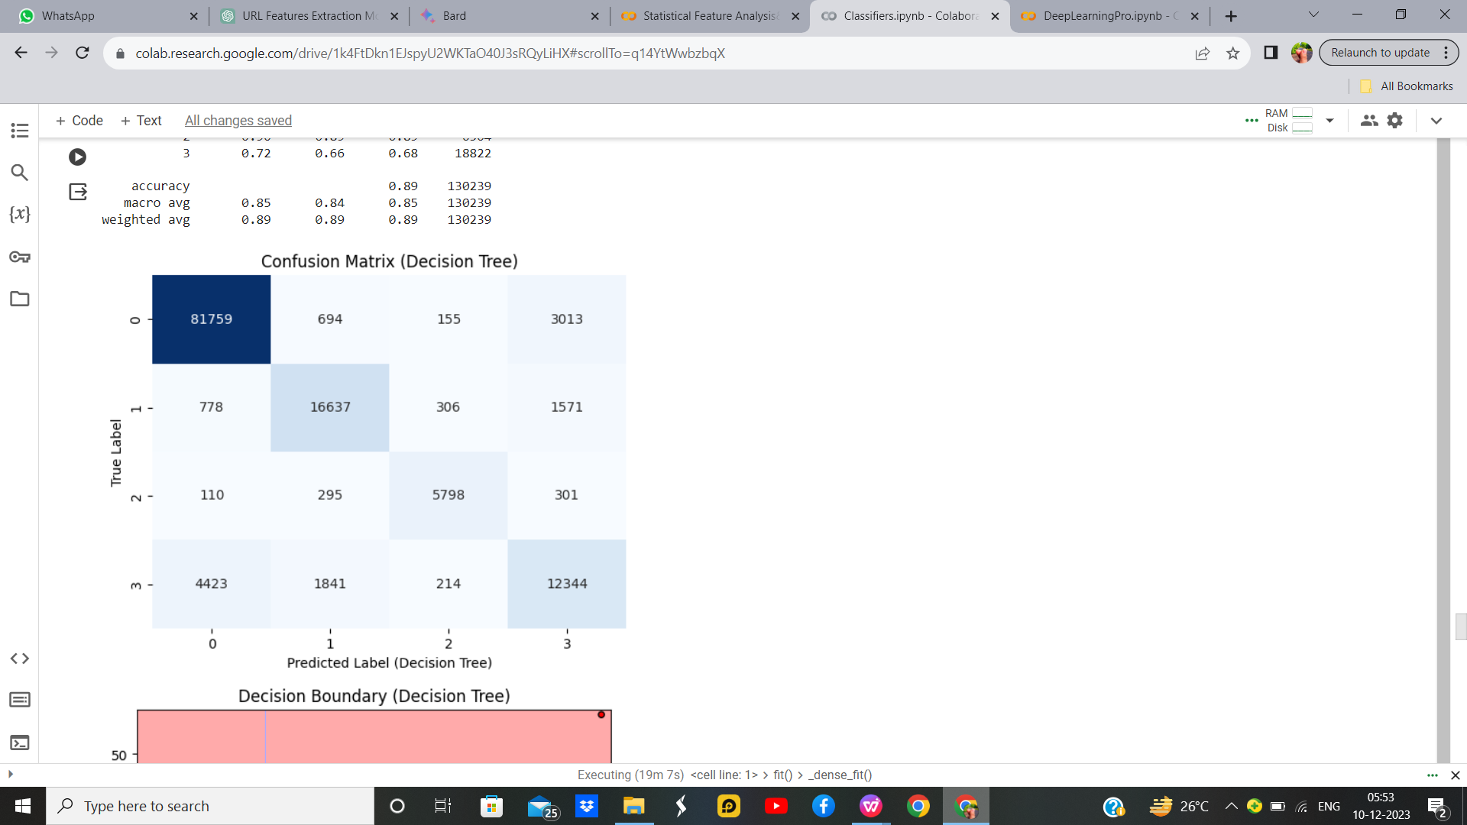
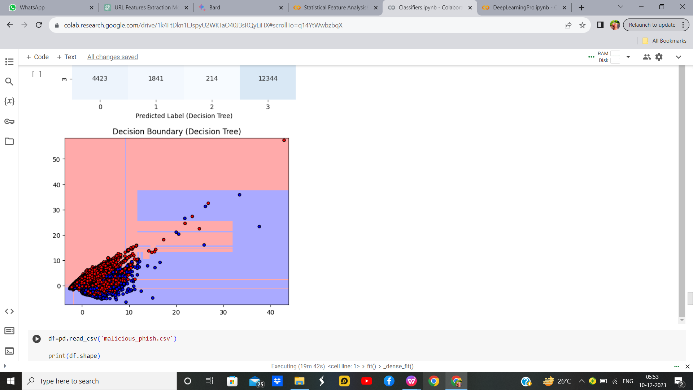
Decision Tree without Hyper parameter

Slide 37
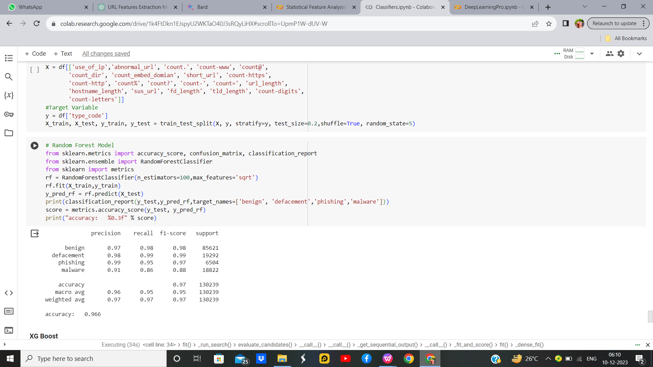
Random Forest Output

Slide 38
Comparisons Table
S.No | Algorithm name | Test Size | Random State | Grid Search CV | Accuracy
1 | KMeans with KNN | 0.2 | 42 | n_neighbors: 3, 5, 7, 9 | 82.05%
2 | Fuzzy C-Means with KNN | 0.2 | 42 | n_neighbors: 3, 5, 7, 9 | 71.79%
3 | KMeans with SVM | 0.2 | 42 | 0.1, 1, 10 | 30.77%
4 | Bayesian Classifier | 0.2 | 42 | np.logspace(0, -9, num=100) | 71.79%
5 | Naïve Bayes Classifier | 0.2 | 42 | np.logspace(0, -9, num=100) | 71.79%
6 | Decision Tree | 0.2 | 42 | 'criterion': ['gini', 'entropy'], 'max_depth': [None, 10, 20, 30, 40, 50], 'min_samples_split': [2, 5, 10], 'min_samples_leaf': [1, 2, 4] | 82.05%

Slide 39
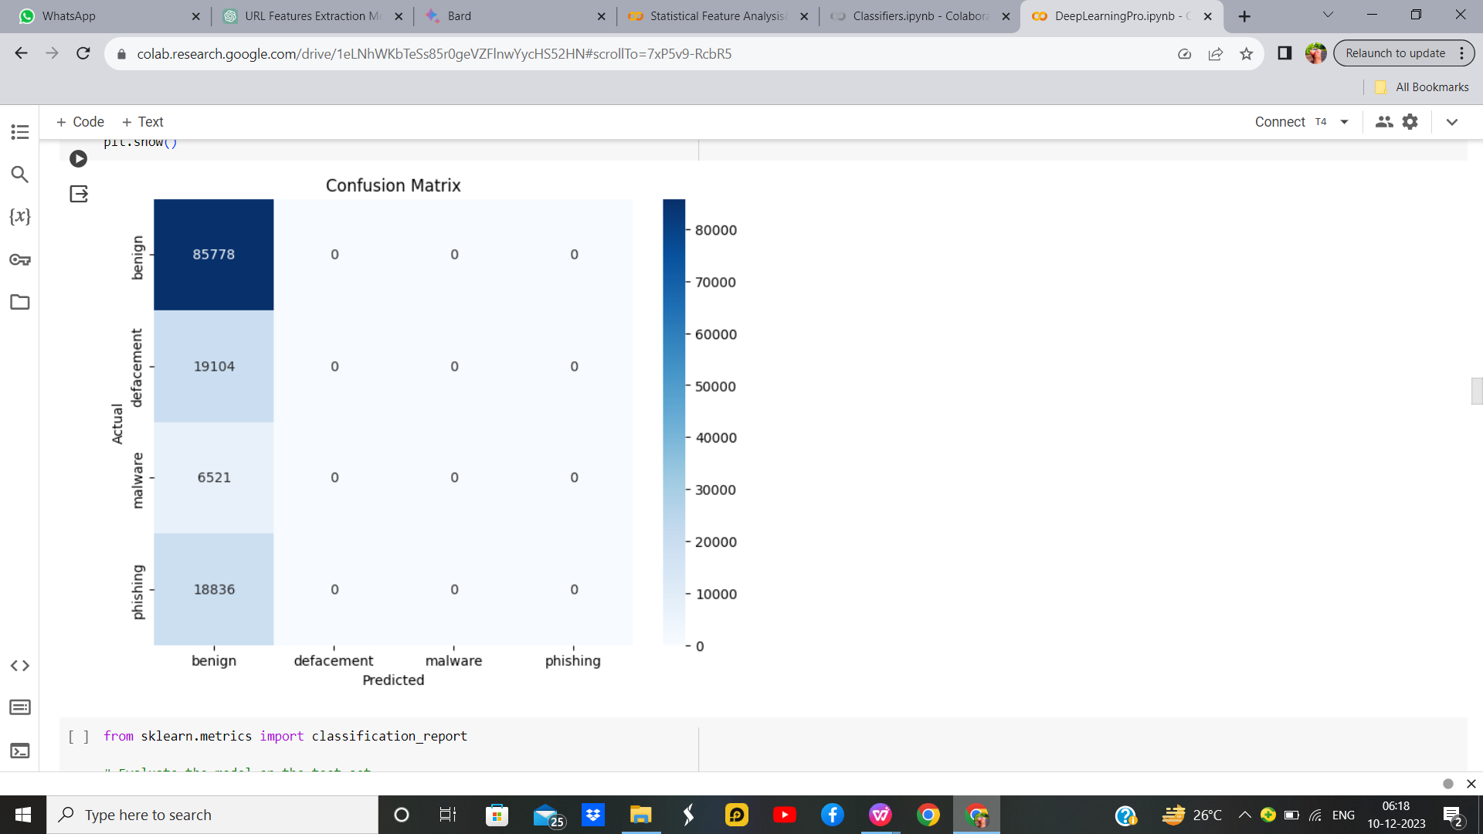
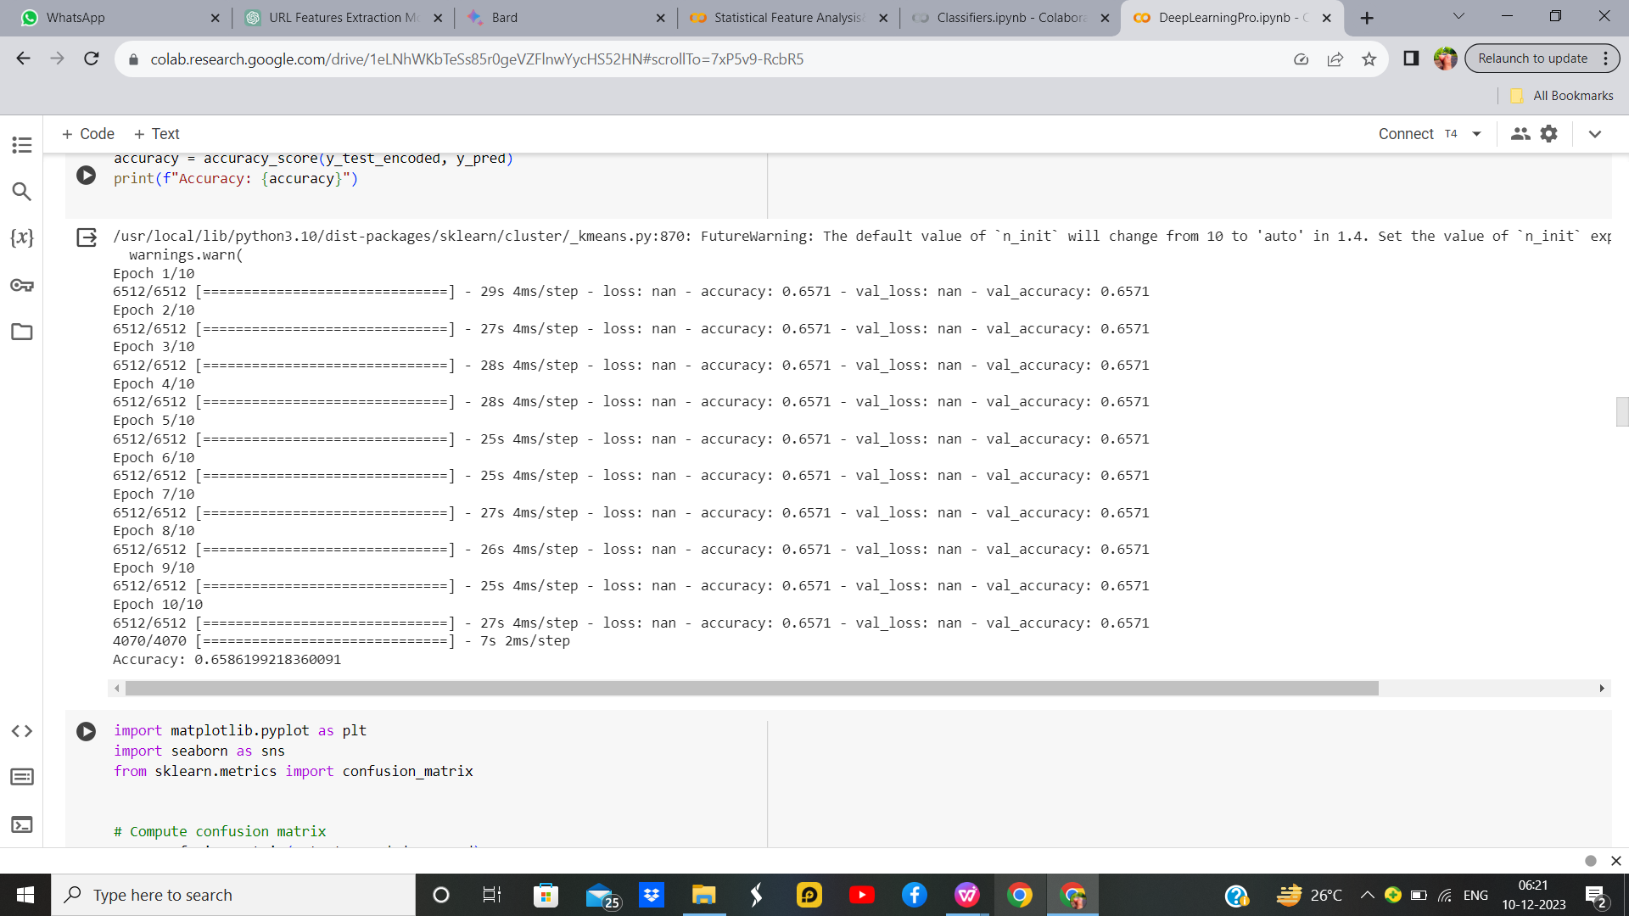
K-Means with Convolutional Neural Network with Hyperparameter
S. No | Parameter Name | Value
1 | Epochs | 10
2 | Accuracy | 65.86%
3 | Precision | 0.66
4 | Recall | 1.00
5 | F1 Score | 0.736
6 | Optimizer | Adam
7 | Learning Rate | 0.001
8 | Batch | 64

Slide 40
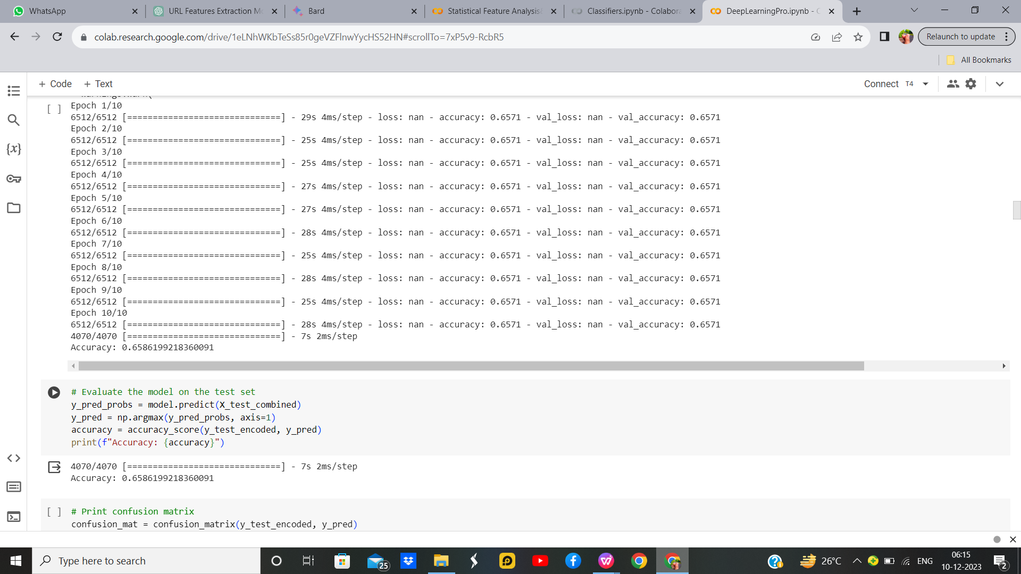
K-Means with Convolutional Neural Network without Hyperparameter

Slide 41
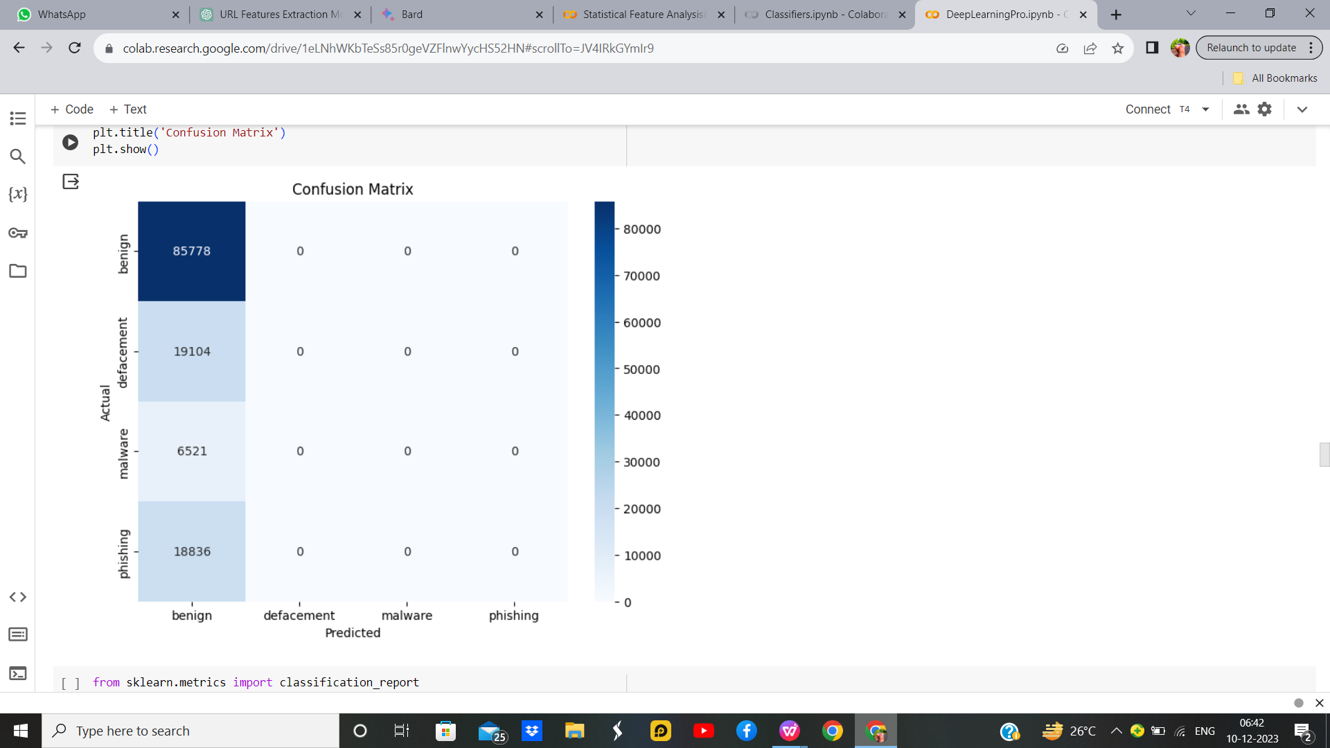
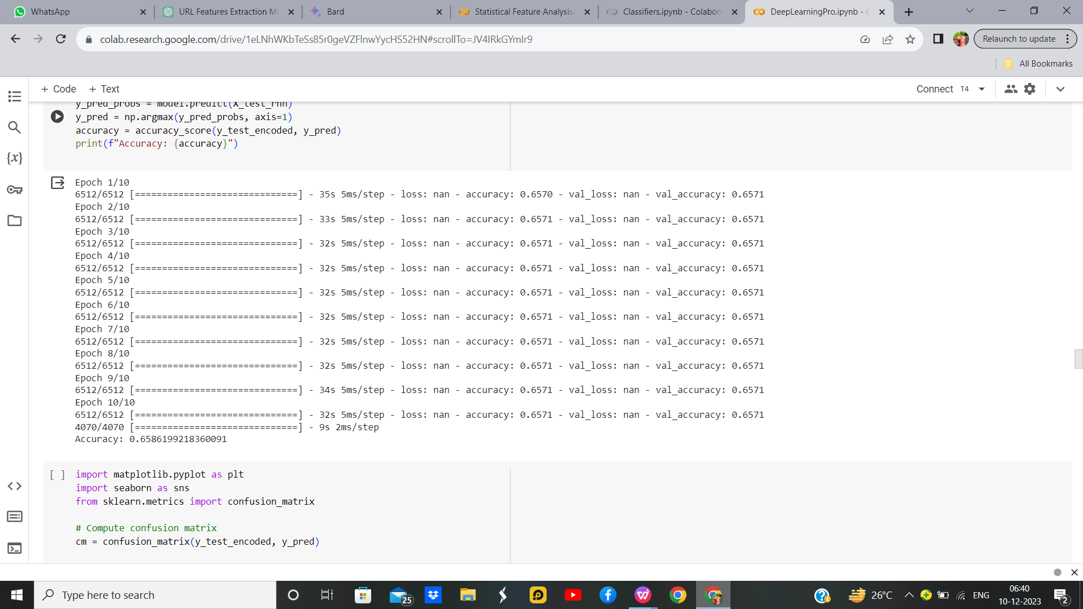
RNN With Hyperparameter:
S. No | Parameter Name | Value
1 | Epochs | 10
2 | Accuracy | 65.86%
3 | Precision | 0.66
4 | Recall | 1.00
5 | F1 Score | 0.76
6 | Optimizer | Adam
7 | Learning Rate | 0.001

Slide 42
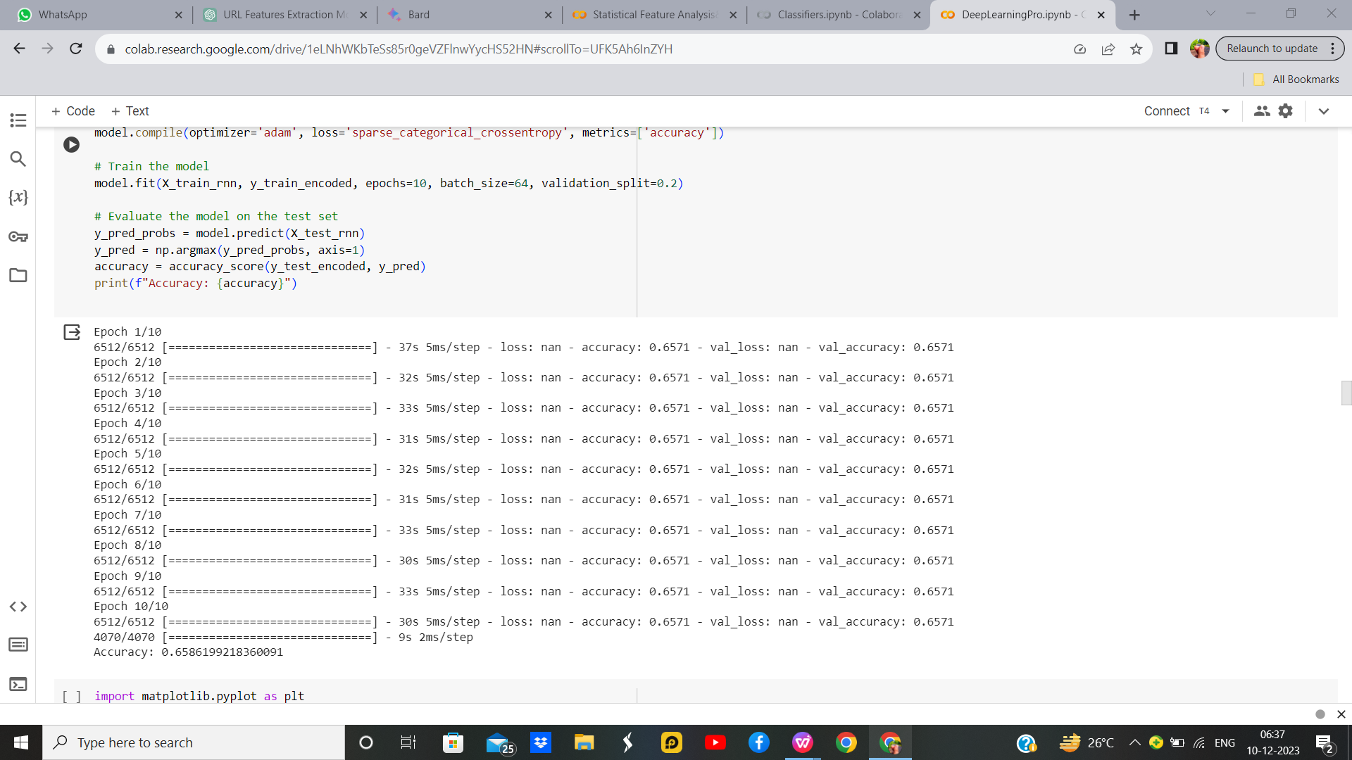

RNN without Hyperparameter:

Slide 43


LSTM with Hyperparameter
S. No | Parameters | Value
1 | Epochs | 10
2 | Accuracy | 65.86%
3 | Training Loss
4 | Validation Accuracy
5 | Validation Loss
6 | Testing Accuracy
7 | Batch Size | 64
8 | Loss | sparse_categorical_crossentropy
9 | Optimizer | adam
10 | Activation Function | Softmax
11 | LSTM Unit | 50
12 | Learning rate | 0.001
13 | Test size | 0.2

Slide 44


LSTM without Hyperparameter

Slide 45


GRU With Hyperparameter

Slide 46


GRU With Hyper parameter 1,2

Slide 47
Comparition Table
S. No | Model | Value
1 | K Means With CNN | 0.658
2 | RNN | 0.658
3 | LSTM | 0.657
4 | GRU | 0.658

Slide 48
CONCLUTION
The Malicious URL detection demonstrates superior performance across Regression and Classification models, excelling particularly well in the Random Forest Classifier, achieving an impressive accuracy rate of 96.6%. However, its efficacy diminishes when implemented in neural network models. The robustness and interpretability of the Random Forest Classifier contribute to its success in handling the complexity of the Malicious URL detection task, outperforming other models and establishing itself as the preferred choice for accurate and reliable predictions, attaining an unparalleled accuracy benchmark of 96.6%. This underscores the significance of model selection in optimizing outcomes for the specific challenges posed by Malicious URL detection.

Slide 49


